Slide 1
The Multitude of Problems Occurring after Whiplash Injury
Symptoms, Diagnosis and Therapy

Slide 2
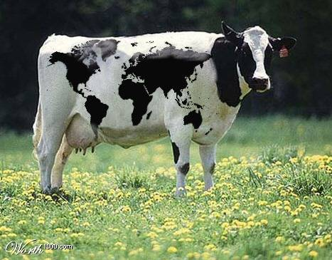
Surgical Treatment of Instability of Upper Cervical Joint
Worldwide Problem
Symptoms
Diagnosis
Indication for surgical treatment
Surgical Technique
Outcome

Slide 3
Worldwide Problem
About 400.000 accidents in Germany with neck injury every year
10 % need medical treatment afterwards
Very different symptoms often cause physicians to suspect psychlogical problems or the patients trying to get money from insurances
Most physicians do not have any knowledge about instability in upper cervical joint and cervico-encephal symptoms
In non-functional x-ray or MRI there are no traumatic signs visible

Slide 4
Indication for Treatment
Prior to indication for surgery
(or non surgical treatment) it is necessary
to make an accurate diagnosis

Slide 5
Symptoms
motor failures , coordination disorders
Pain and dizziness
Visual disorders
Hearing problems with tinnitus
Disturbance of the sense of balance
Sensory losses

Slide 6
Pain and Dizziness
Headache beginning from the neck
Neck and shoulder pain
Body and low back pain
Dizziness (various intensity)
Combination of pain and dizziness

Slide 7
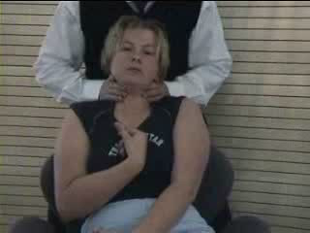
Motor Failures , Coordination Disorders
Simple weakness
Paresis (weakness or spastic)
Fine motor failures or inability to walk
Stumbling
Losing the sense for body feeling

Slide 8
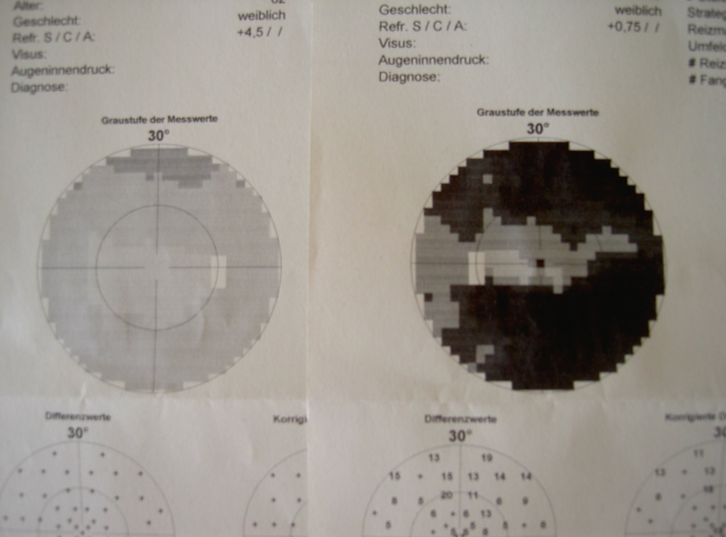
Visual Disorders
Weakness
Disturbance in focusing
Change of color seeing
Worse nocturnal vision
Field of vision

Slide 9
Hearing problems with tinnitus
Change in hearing quality
Loss of hearing
Phonophobia
Tinnitus (mostly high whistle tone)
Feeling pressure behind the ear
Normal hearing is impeded

Slide 10
Disturbance of the sense of balance
Losing the sense for body feeling
Different feelings for left and right part of body
Feeling the position of body in room only with open eyes
Need for crutches

Slide 11
Patho Physiological Hypothesis
Instability of CCJ causes incorrect Micro movement.
Micro movement in CCJ send incorrect information to brainstem.
Brainstem function is disturbed : disturbance of ability for cognition, senses, motoric, coordination and balance

Slide 12
An Acurate Diagnosis Necessitates The Following Evaluations:
Exact anamnesis
Clilnical examination
Neuro-otological special examination
Special radiological processes
Optional halo fixation for one week

Slide 13
Exact Anamnesis
Anamnesis about the time before injury
Accident anamnesis
Early symptoms after accident
Type of treatment
Worse symptoms now
Growing symptoms during the years after the accident

Slide 14
Clinical Examination
Examination of head movements
Dizziness and nausea by head movements?
Muscle tension of the neck, arms and legs
The sense of body feeling
Coordination tests

Slide 15
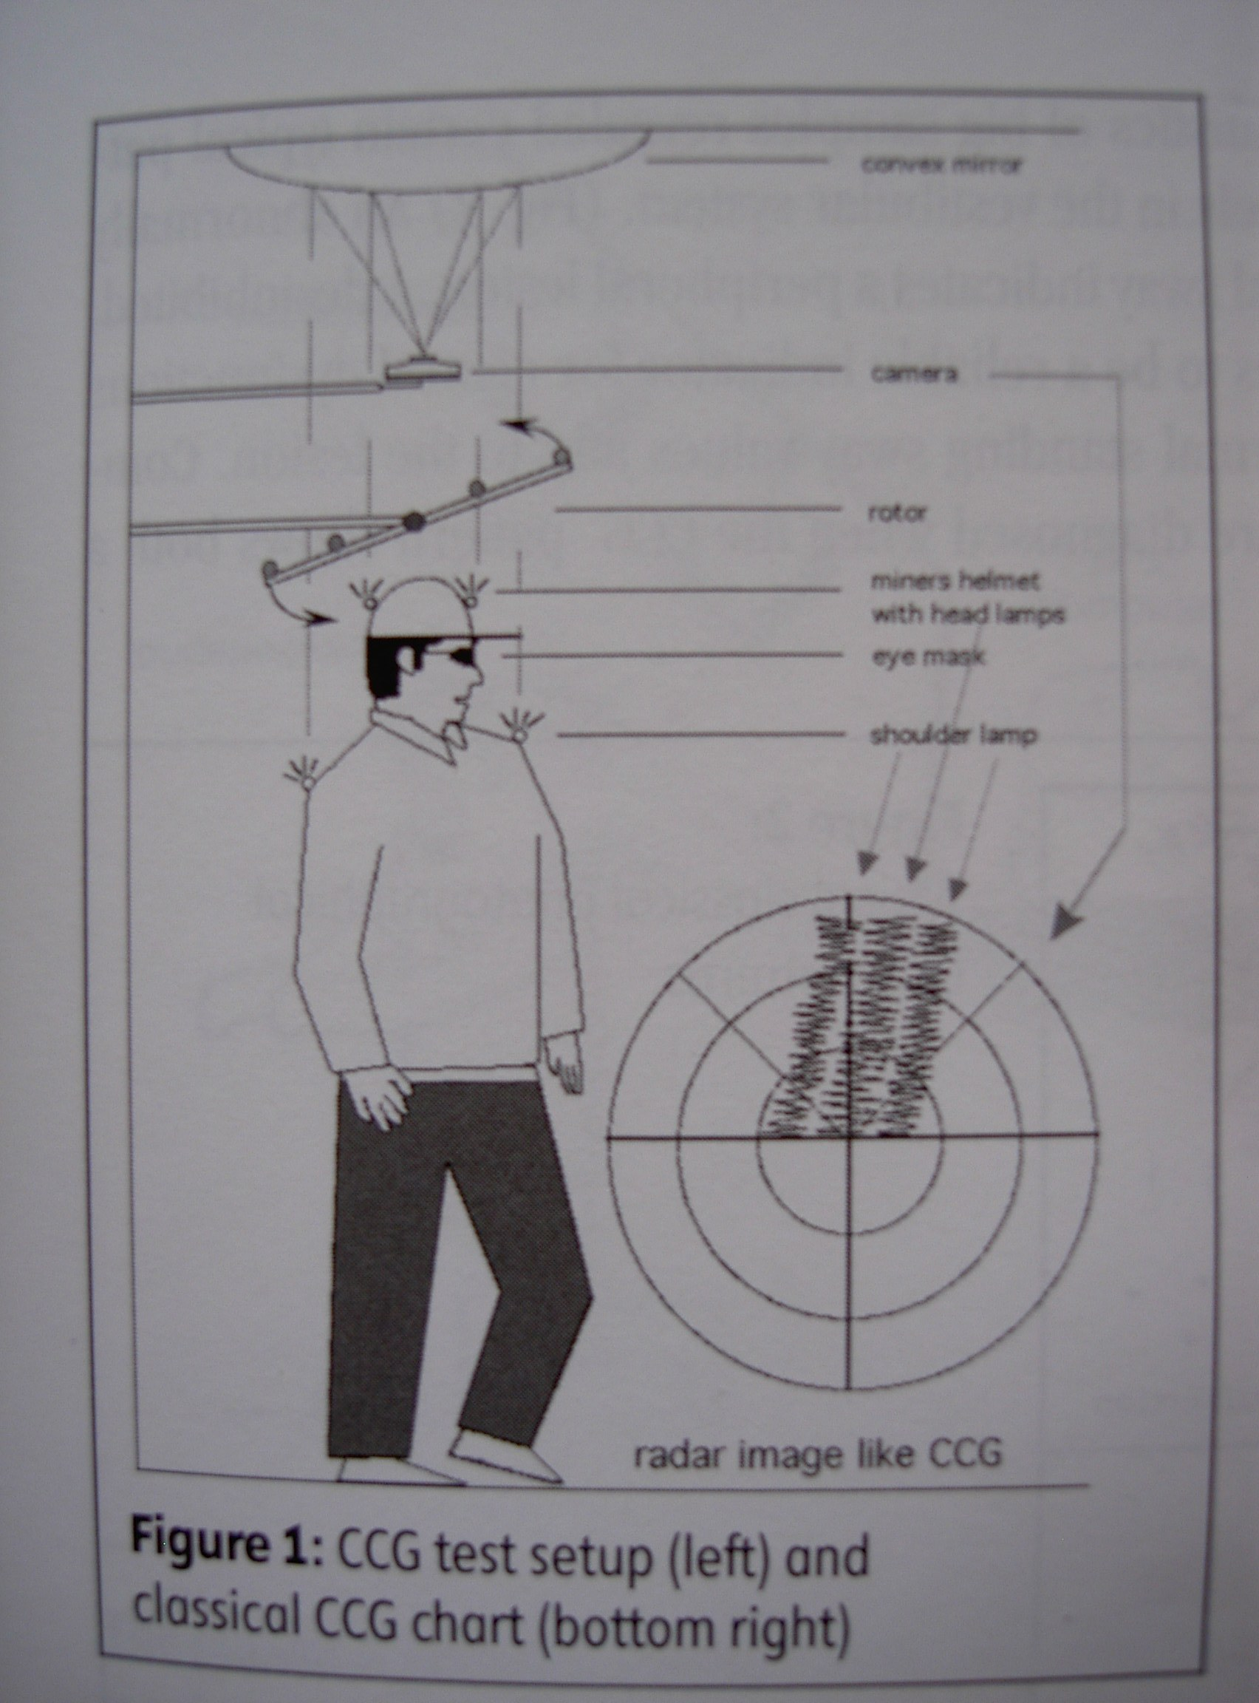
Neuro-Otological Special Examination
Checking of the senses
Seeing, perimetry
Hearing, audiometry
Smelling
Balance Equilibriometry
Craniocorpography

Slide 16
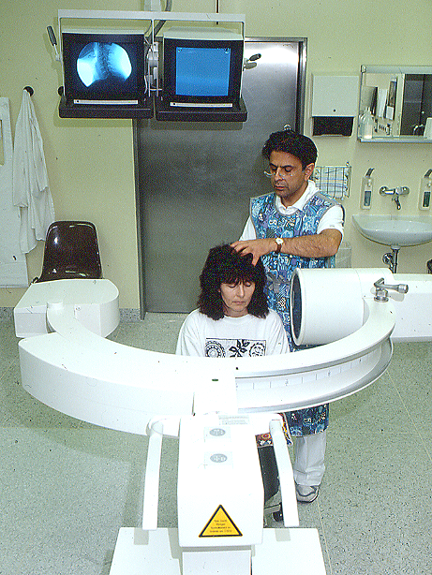
Special Radiological Processes
Functional x-ray (tilting the head with 2 hands)
conventional x-ray of C1/C2
Functional CT
Functional MRI(depiction of alar ligament)
Functional analysis shown by fluoroscopy

Slide 17
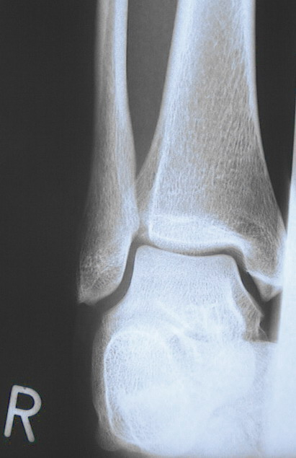
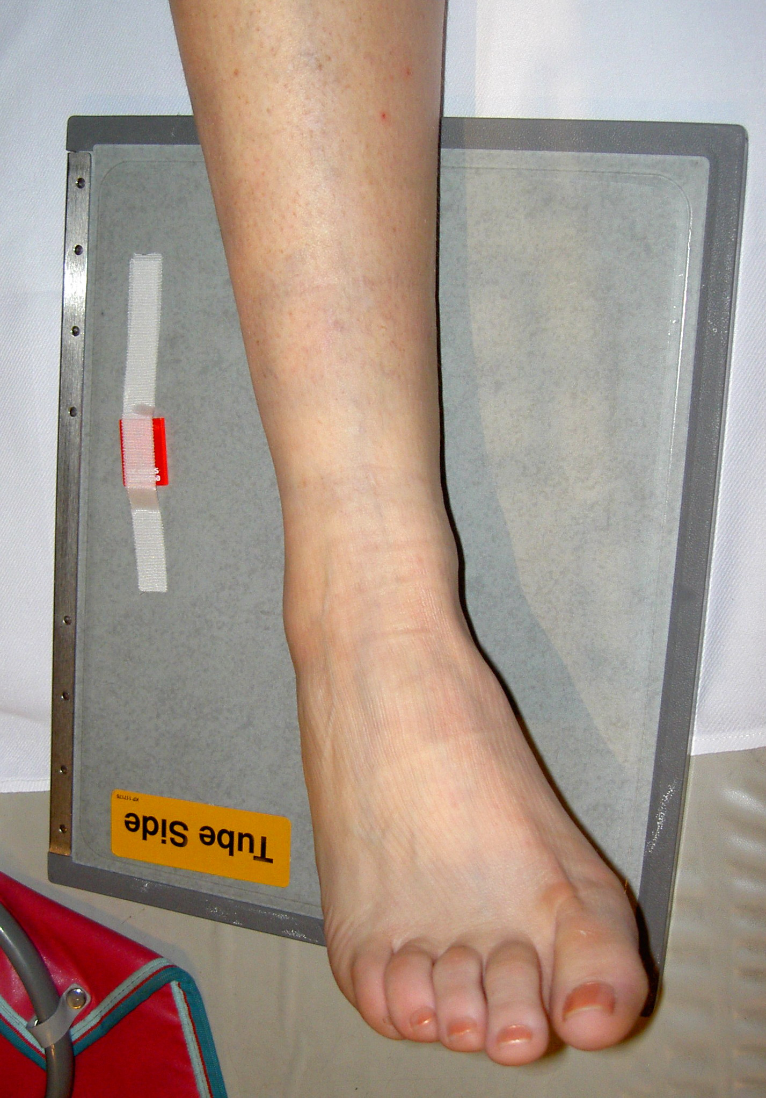
Non Functional X-Ray

Slide 18
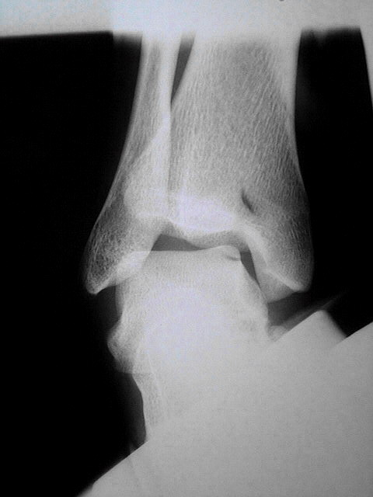
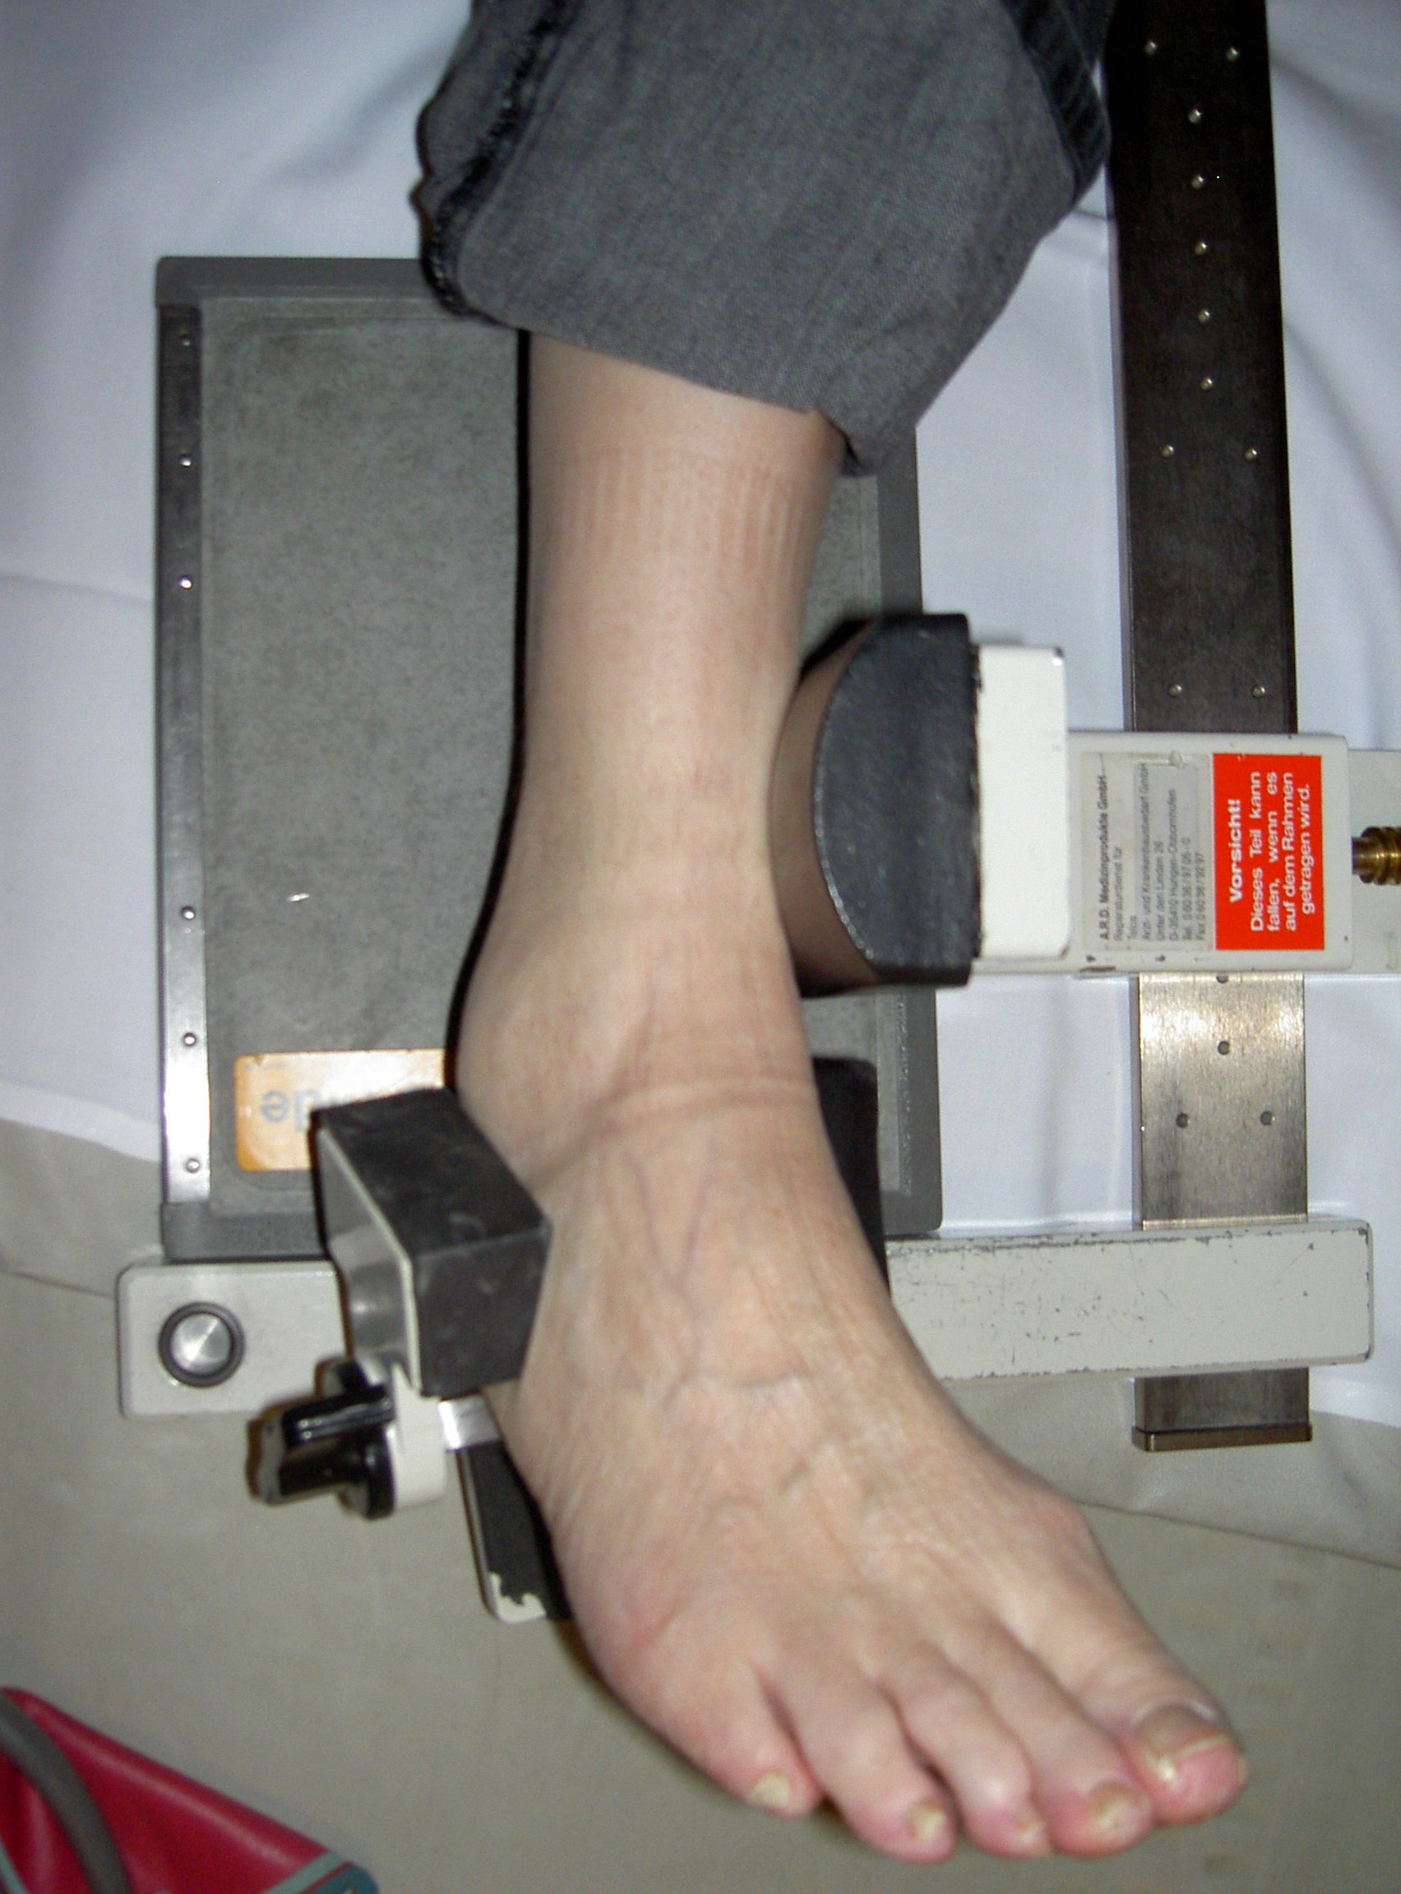
Special Radiological Processes Functional X-Ray

Slide 19
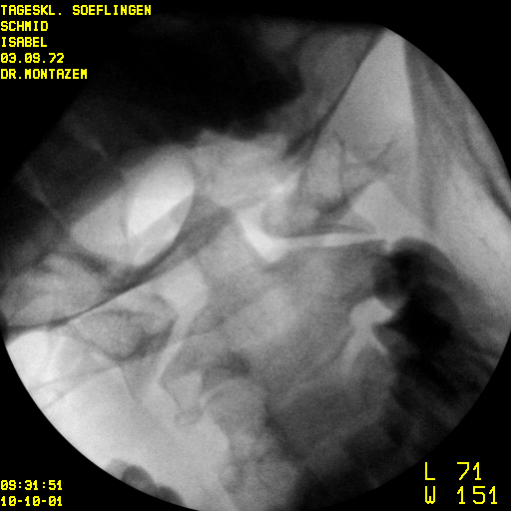
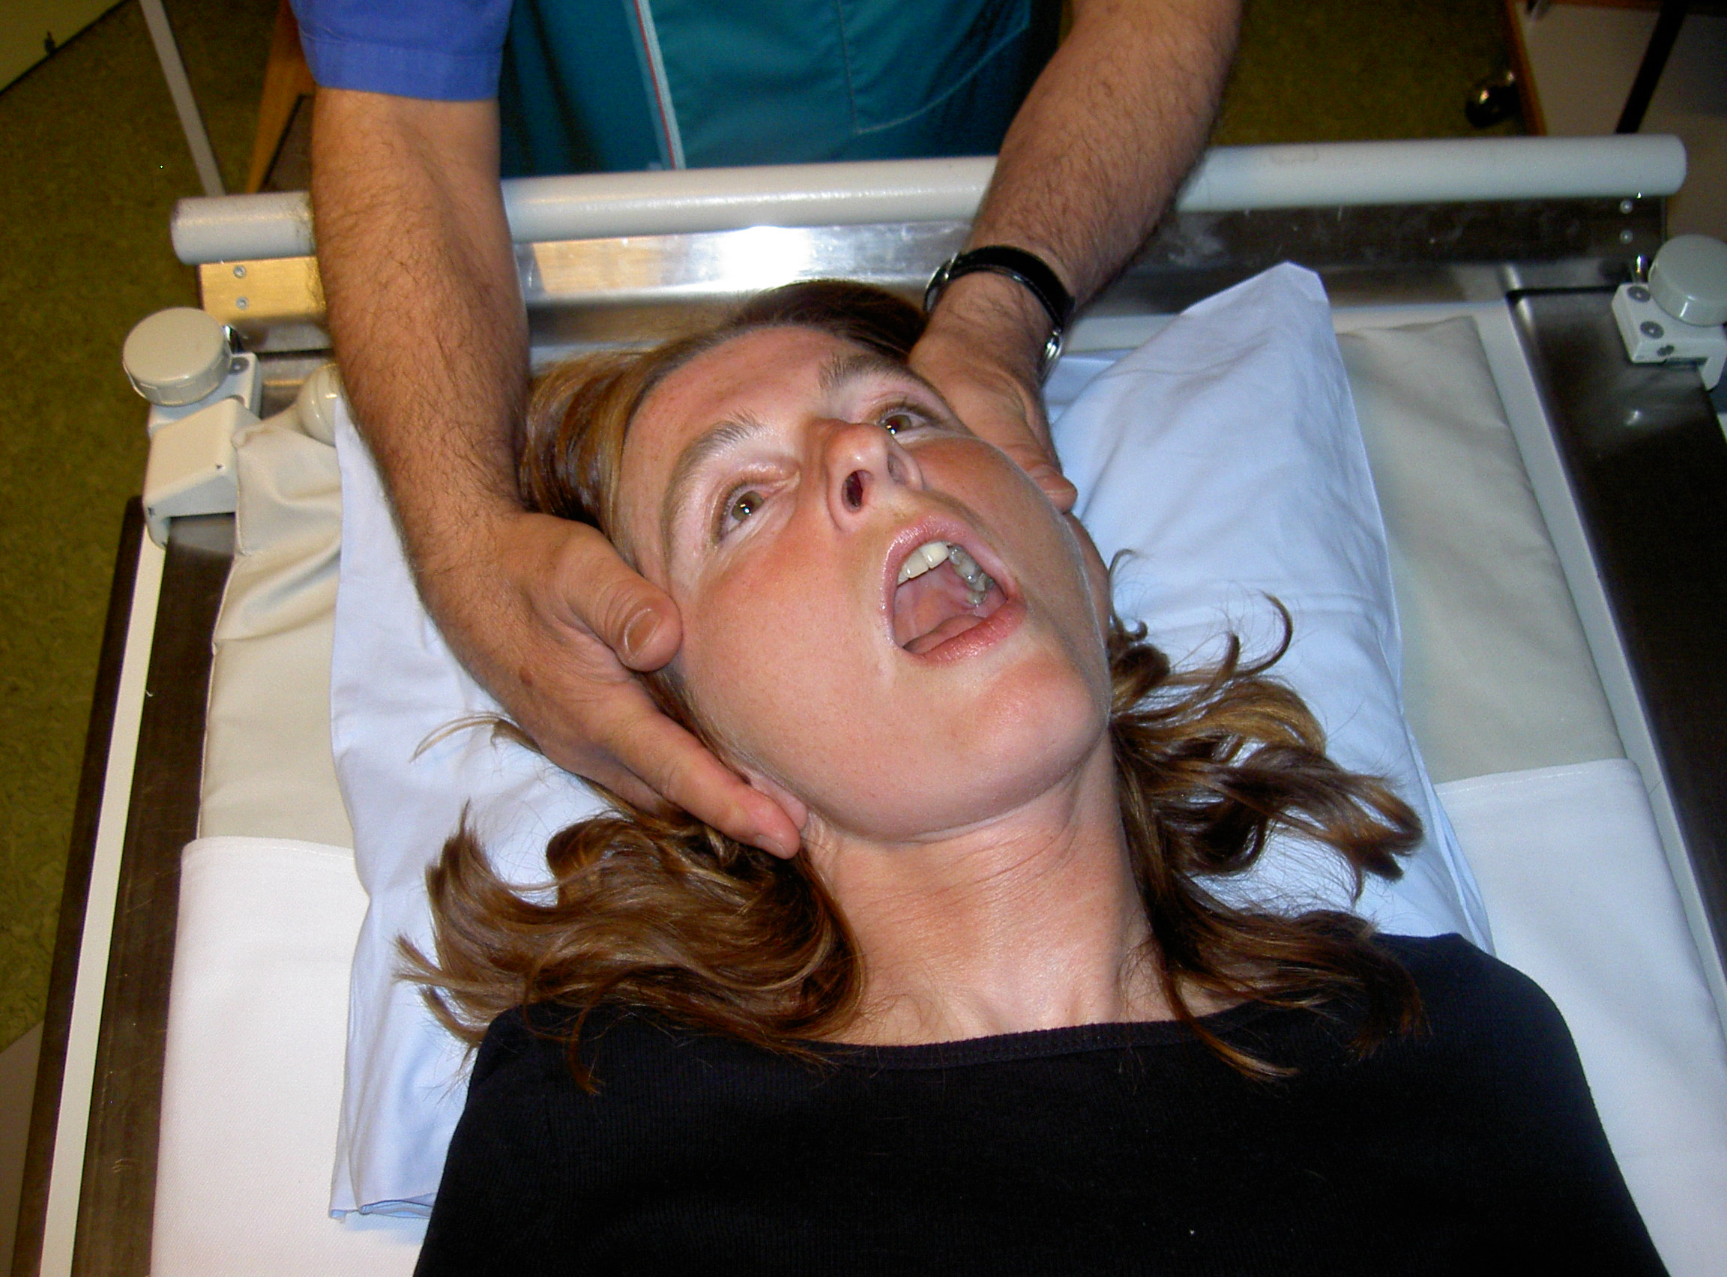
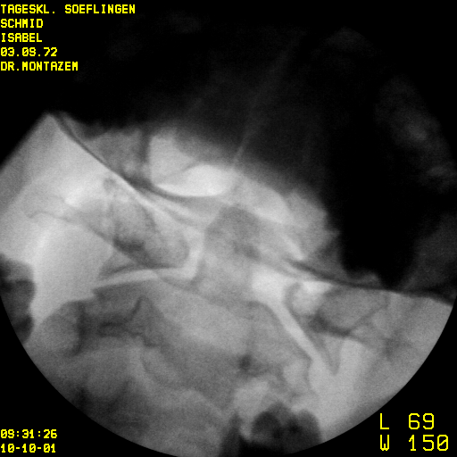
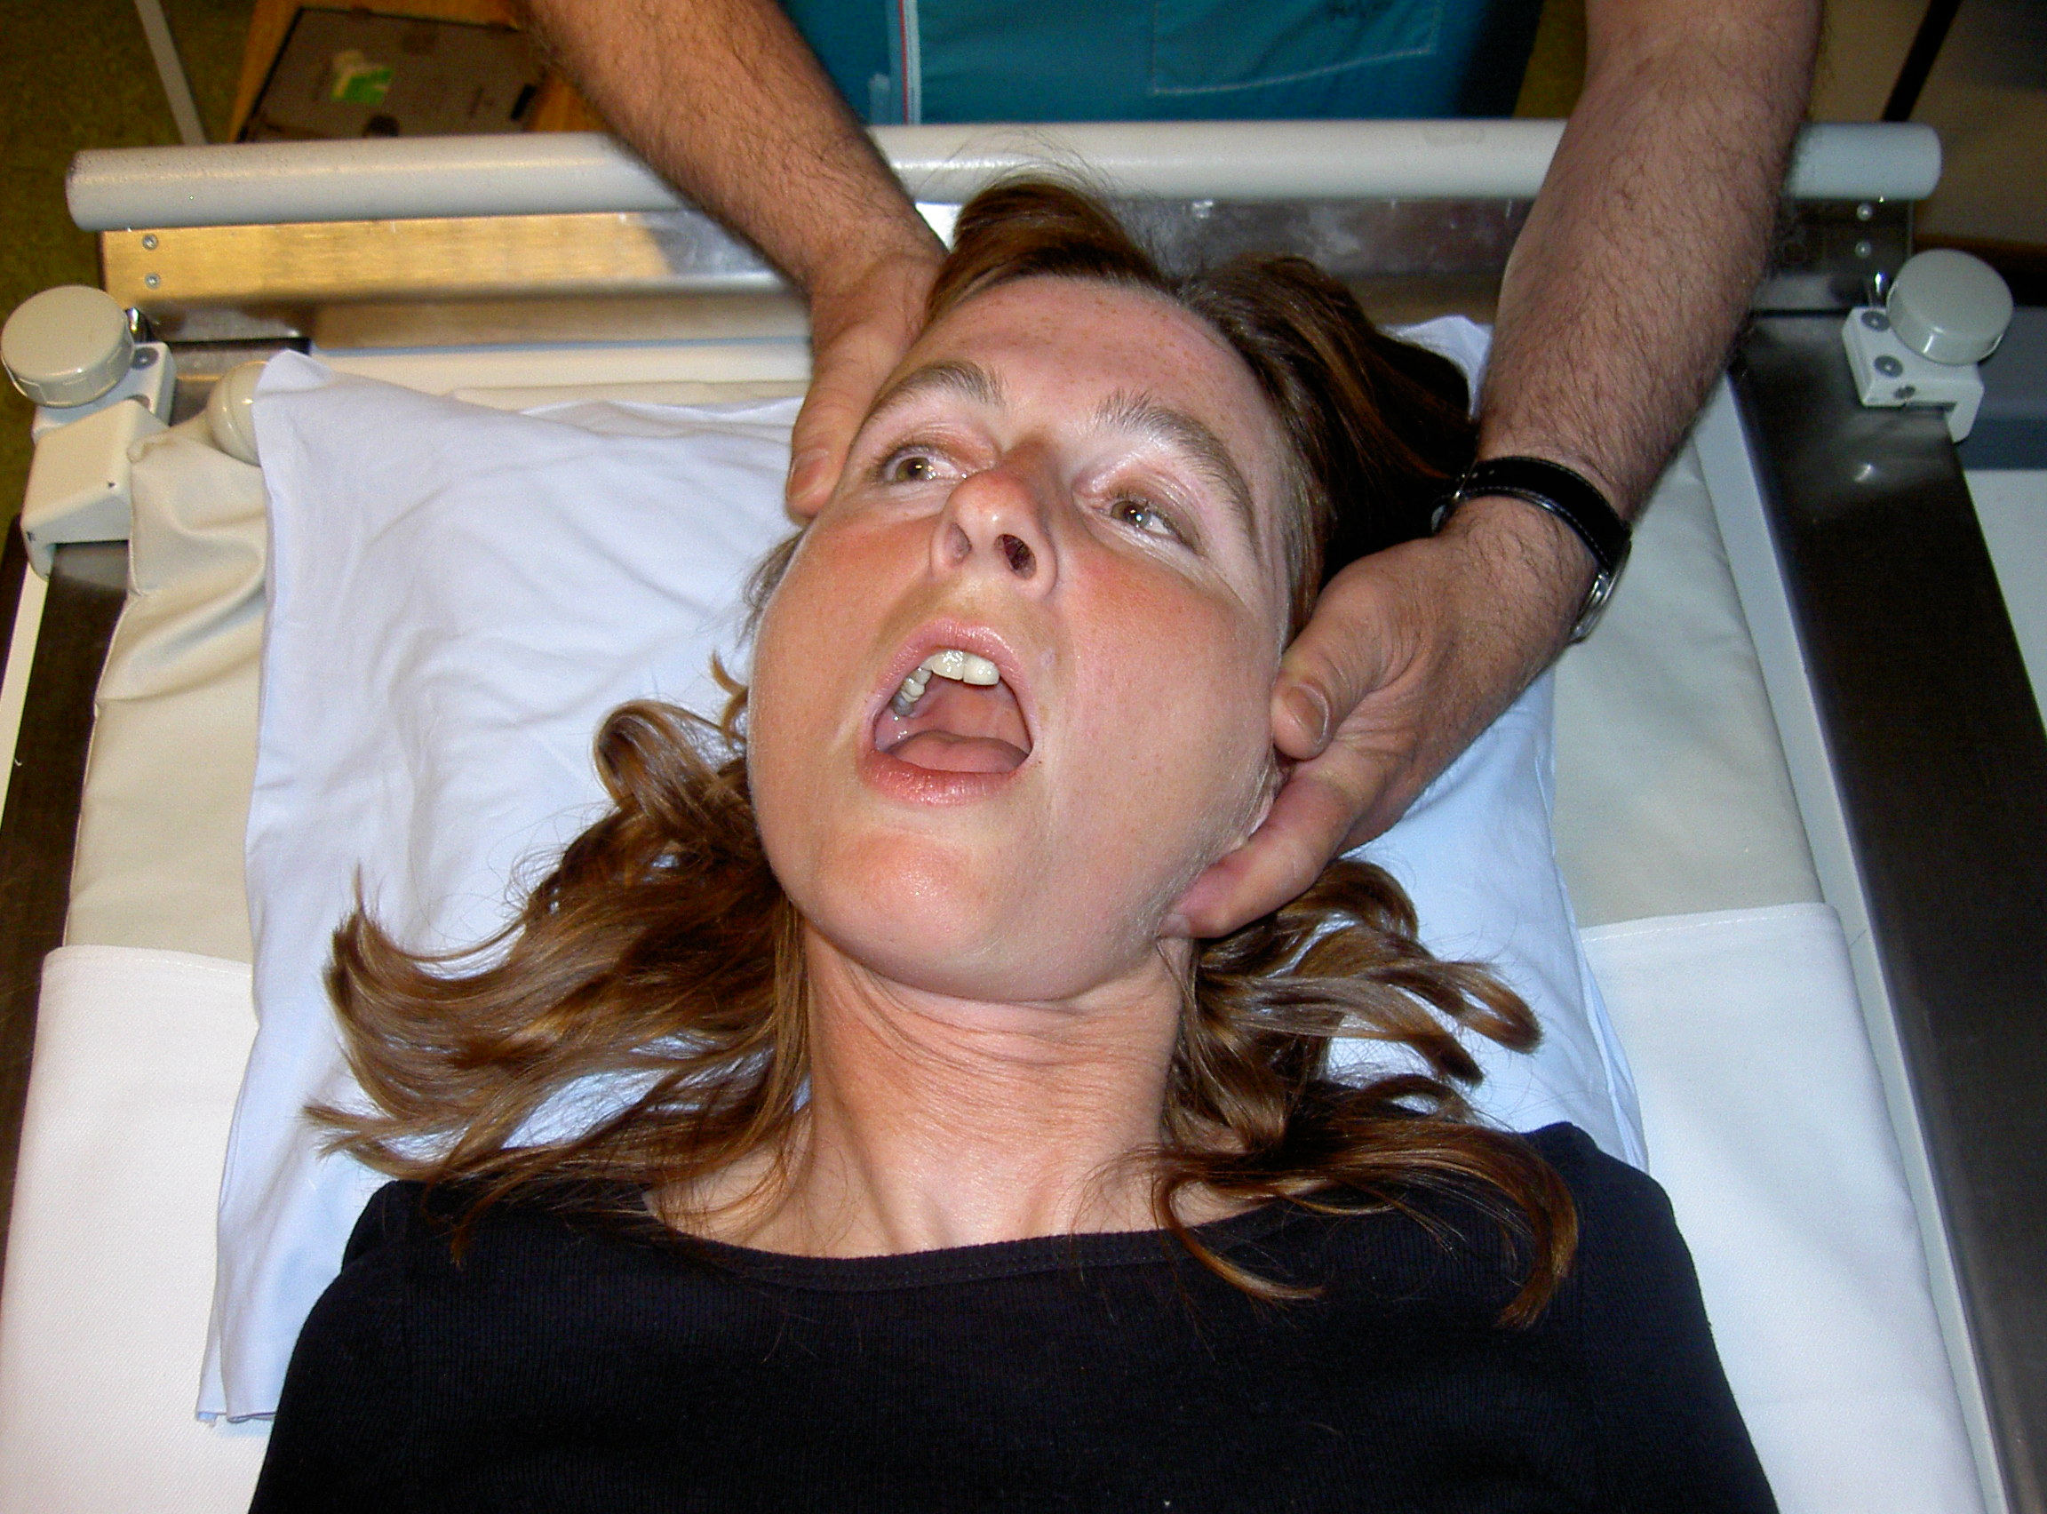
Special Radiological Processes
Head tilting

Slide 20
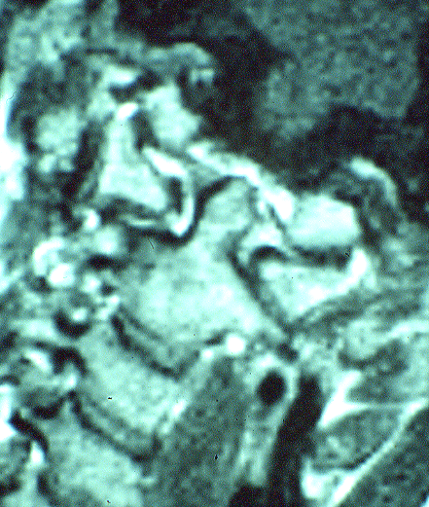
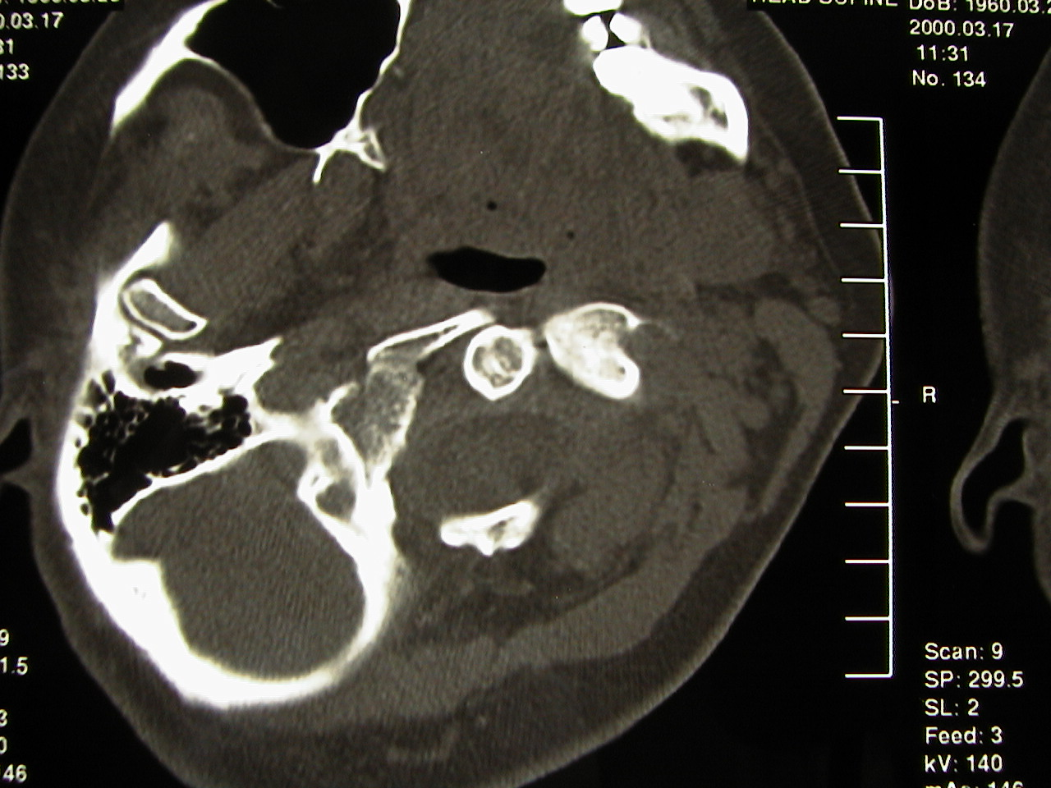
Special Radiological Processes
MR
I
Computer Tomography

Slide 21
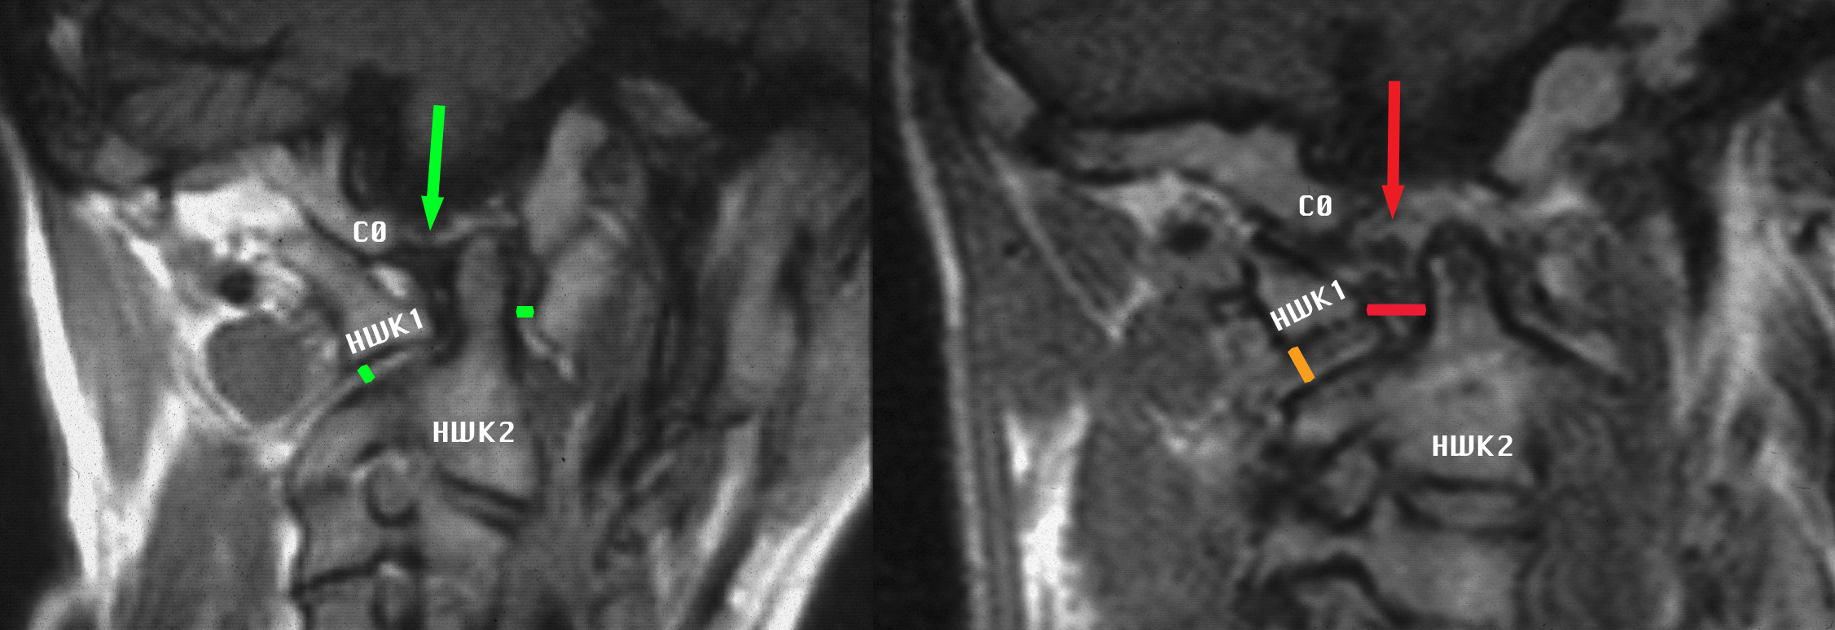
MRI Special Images
Normal Alar Ligament | Ruptured Alar Ligament
Normal distance | Larger distance

Slide 22
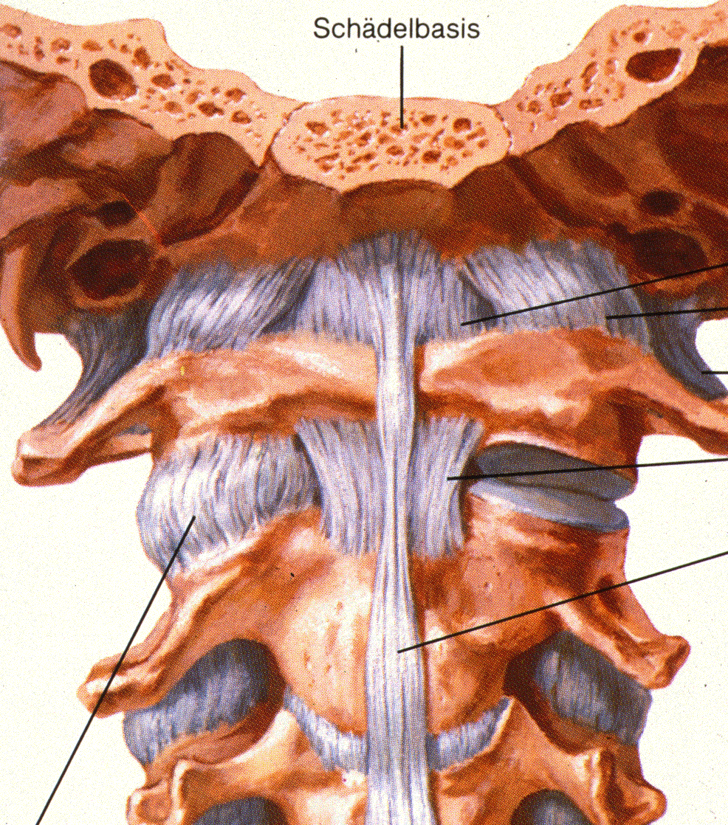
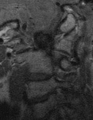
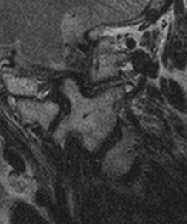
Facet Joint C1C2 in MRI
Special Radiological Processes

Slide 23
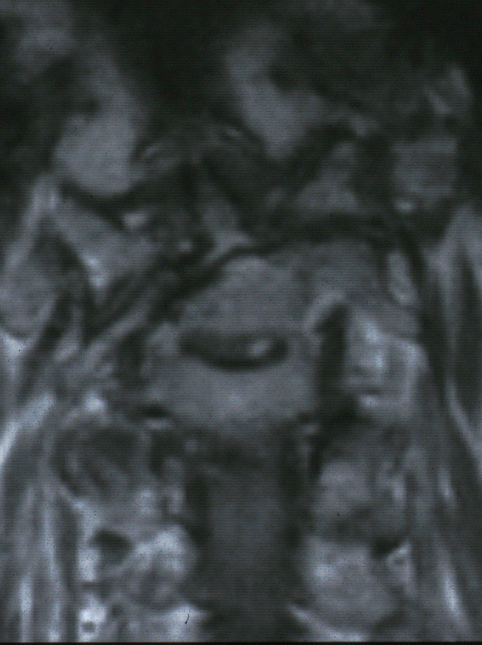
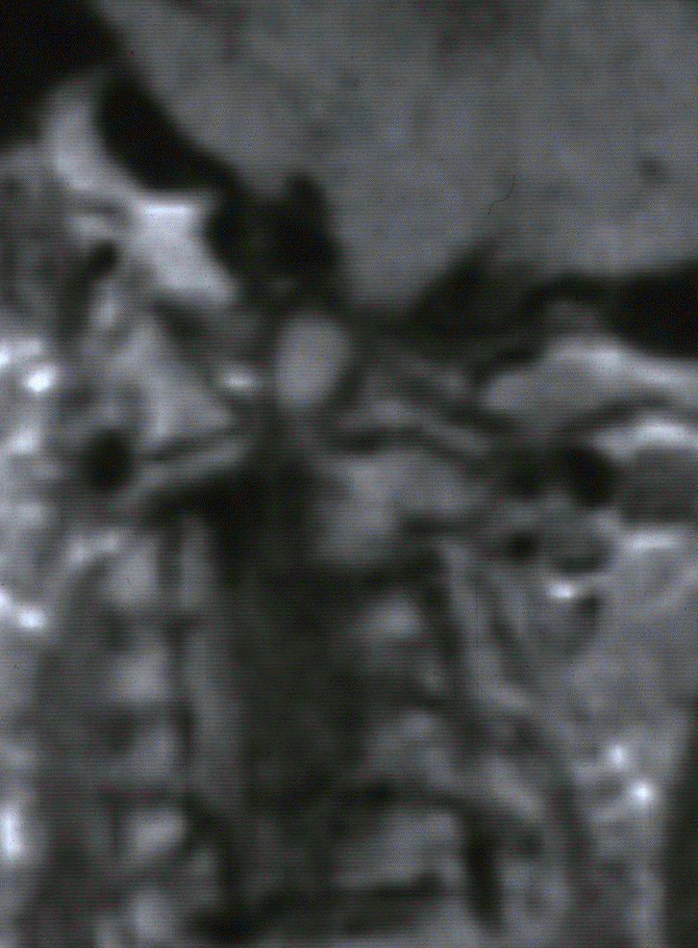
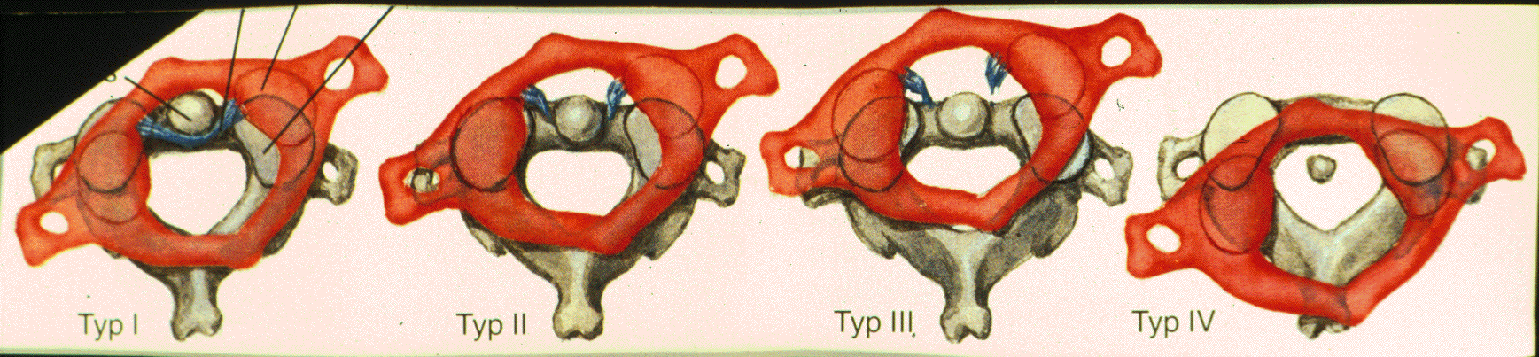
Dens Axis Fracture and Ligamentous Reaction
Complete fracture without ligament rupture
COMPLETE DISLOCATION OF C1 with massive elongation of transverse ligament
Very rare incidence the complete rupture of the transverse ligament

Slide 24
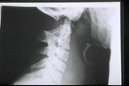
Ligament Rupture between C0and C1 (Functional X-Ray!!)

Slide 25
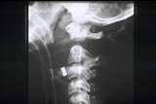
Ligament Rupture between C1and C2 (Functional X-Ray!!)

Slide 26
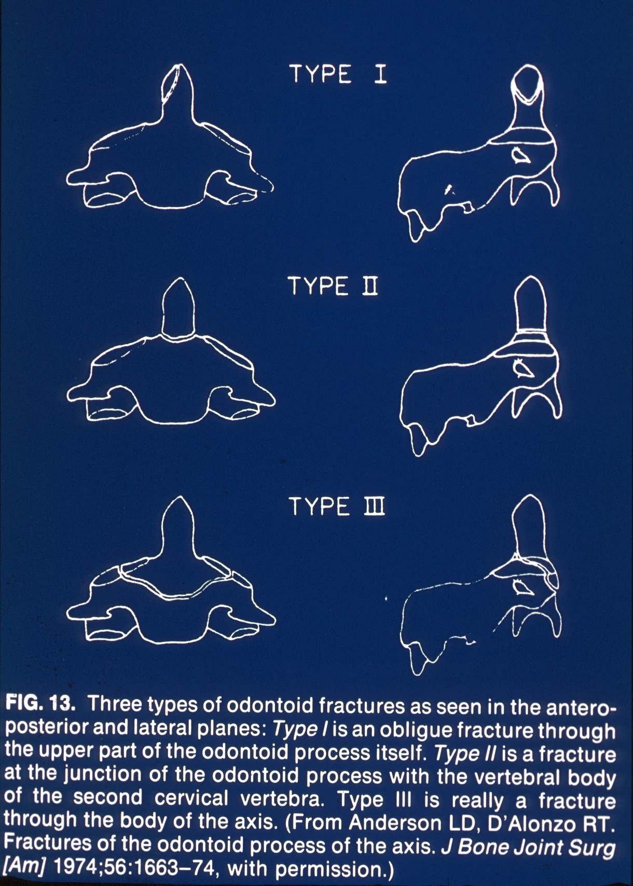
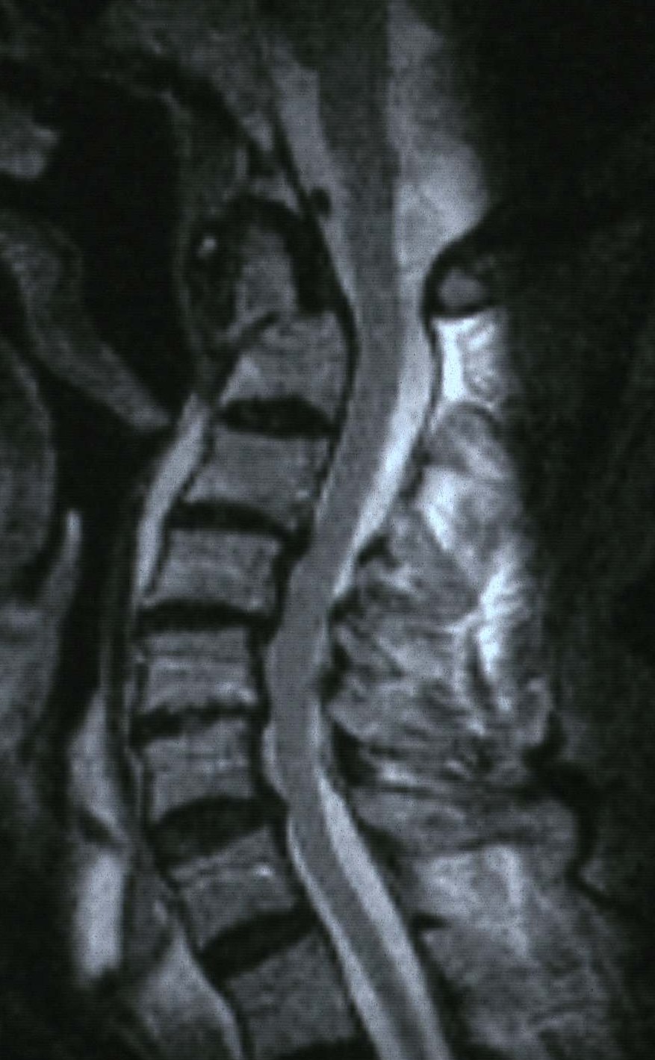
Dens axis fracture

Slide 27
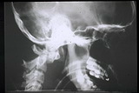
Luxation by Densfractur

Slide 28
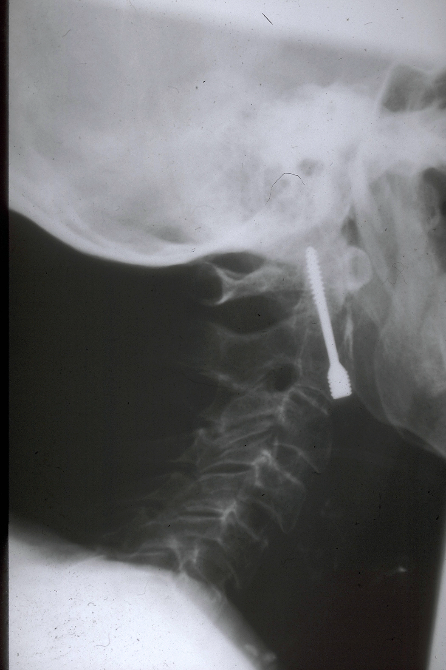
X- Ray After Operation

Slide 29
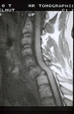
Traumatic Luxation C6/C7

Slide 30
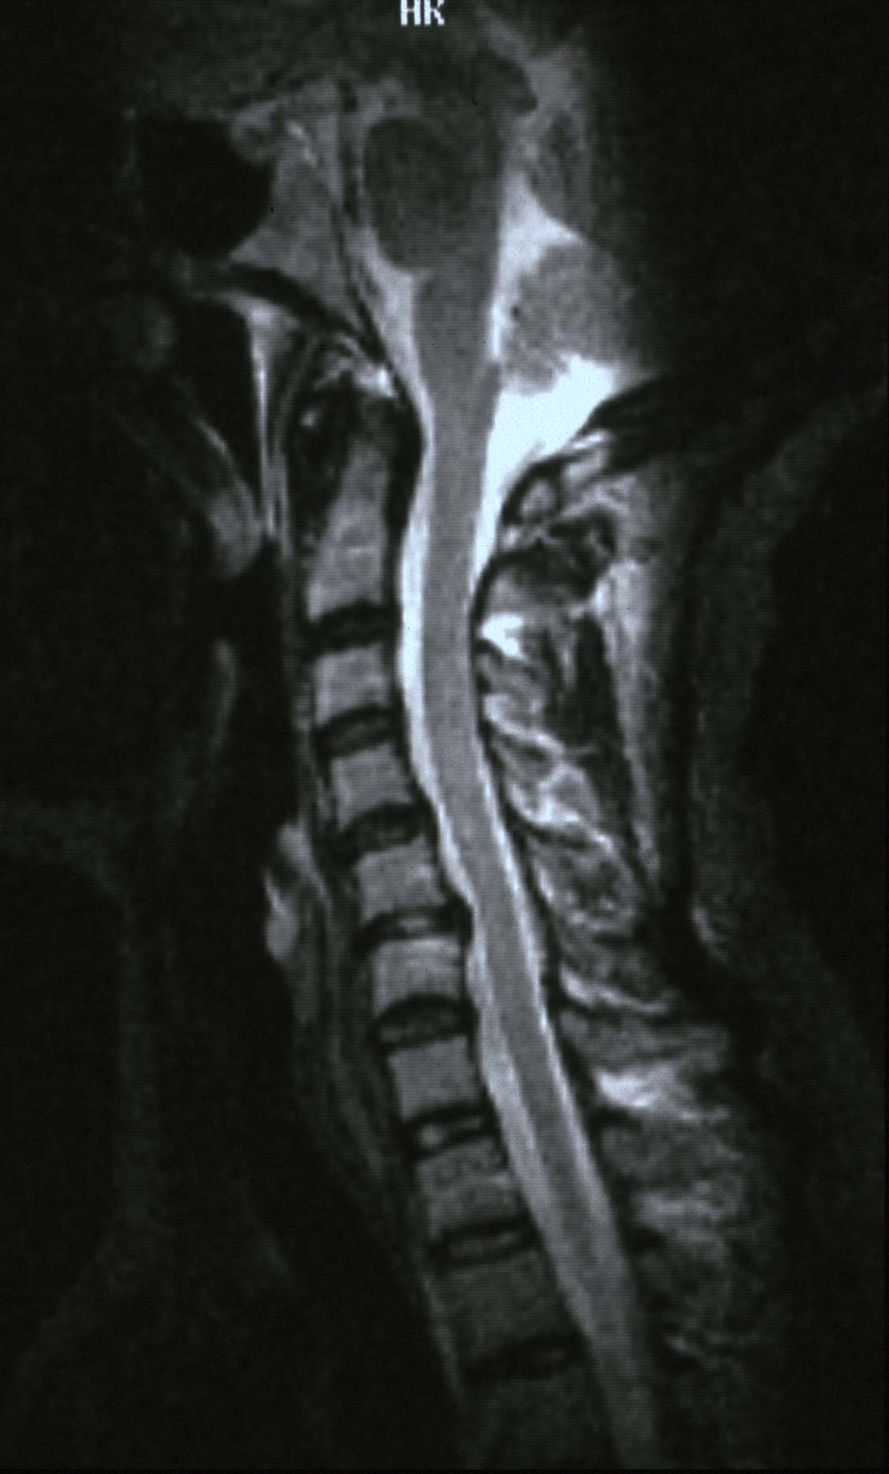
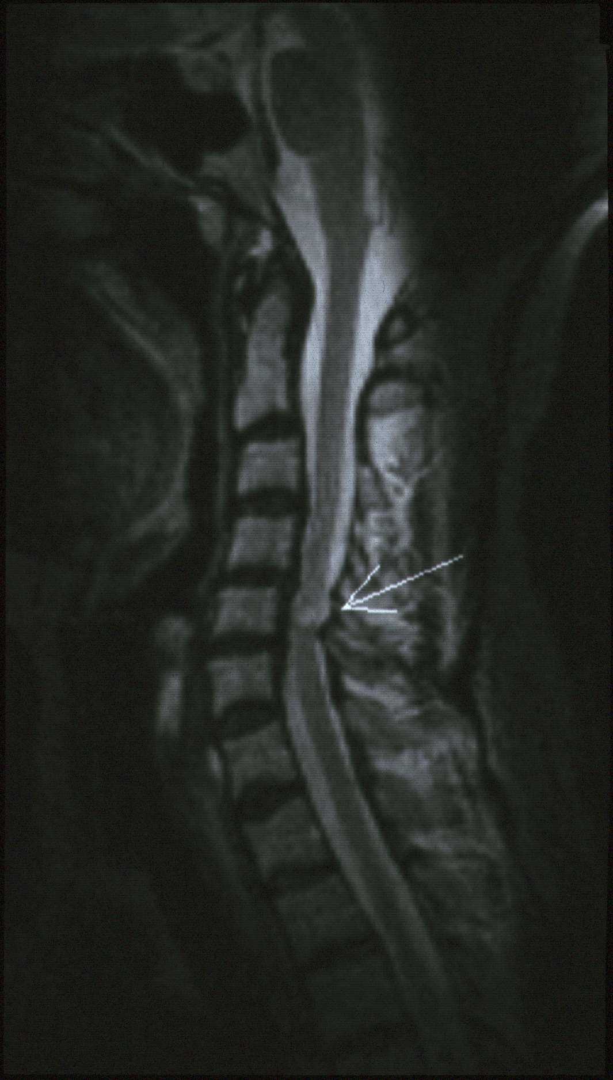
Posttraumatic injuries
posttraumatic meylomalacia
disc herniation

Slide 31
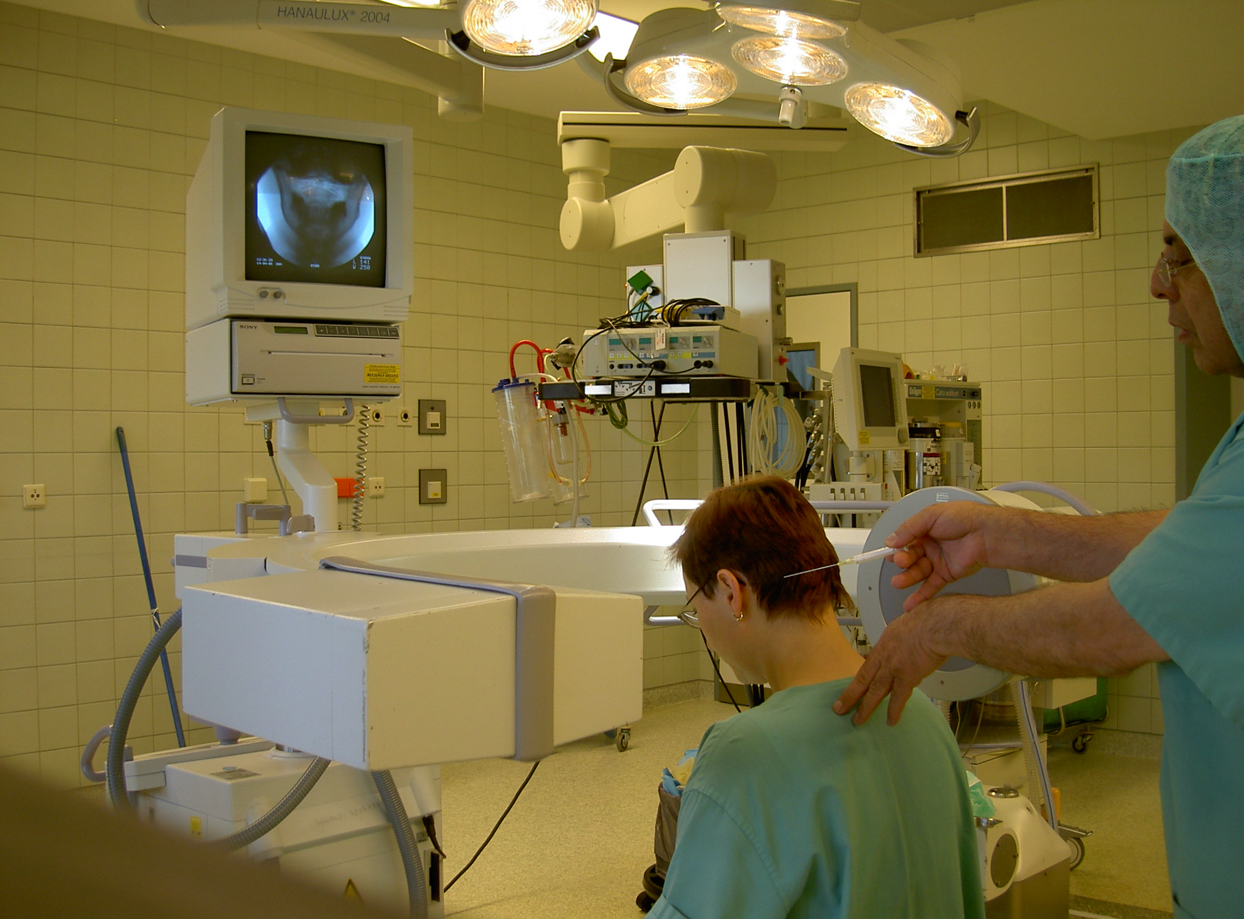
Infiltration Test of C0/C1/C2 under Fluoroscopy ( C-arm )

Slide 32
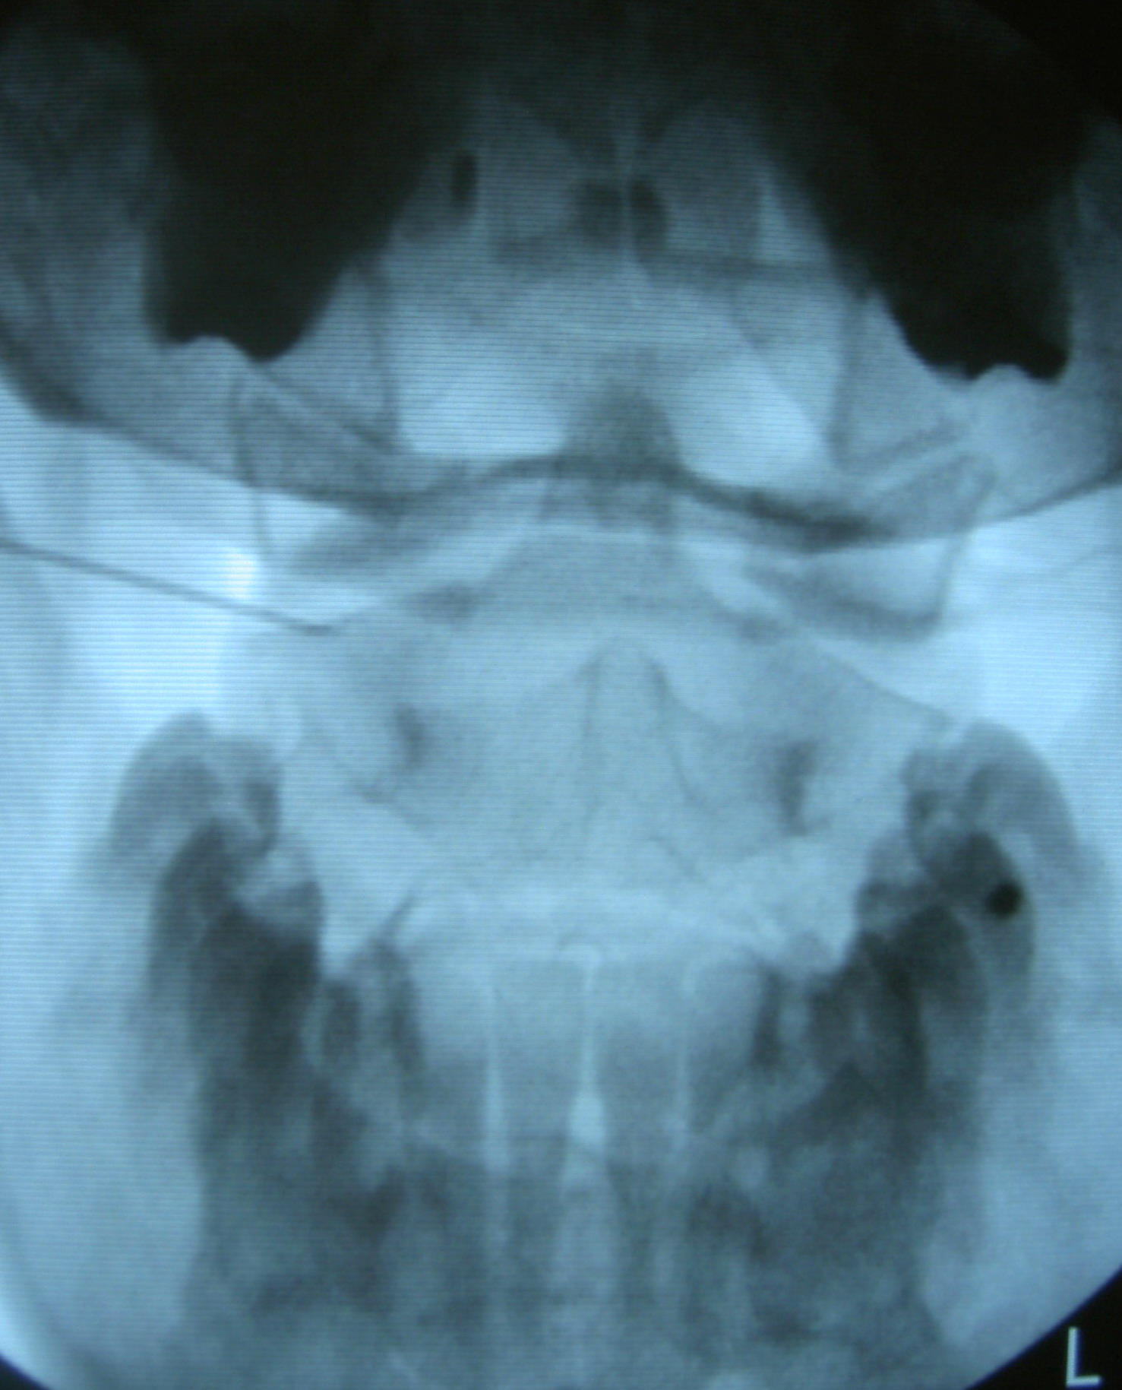
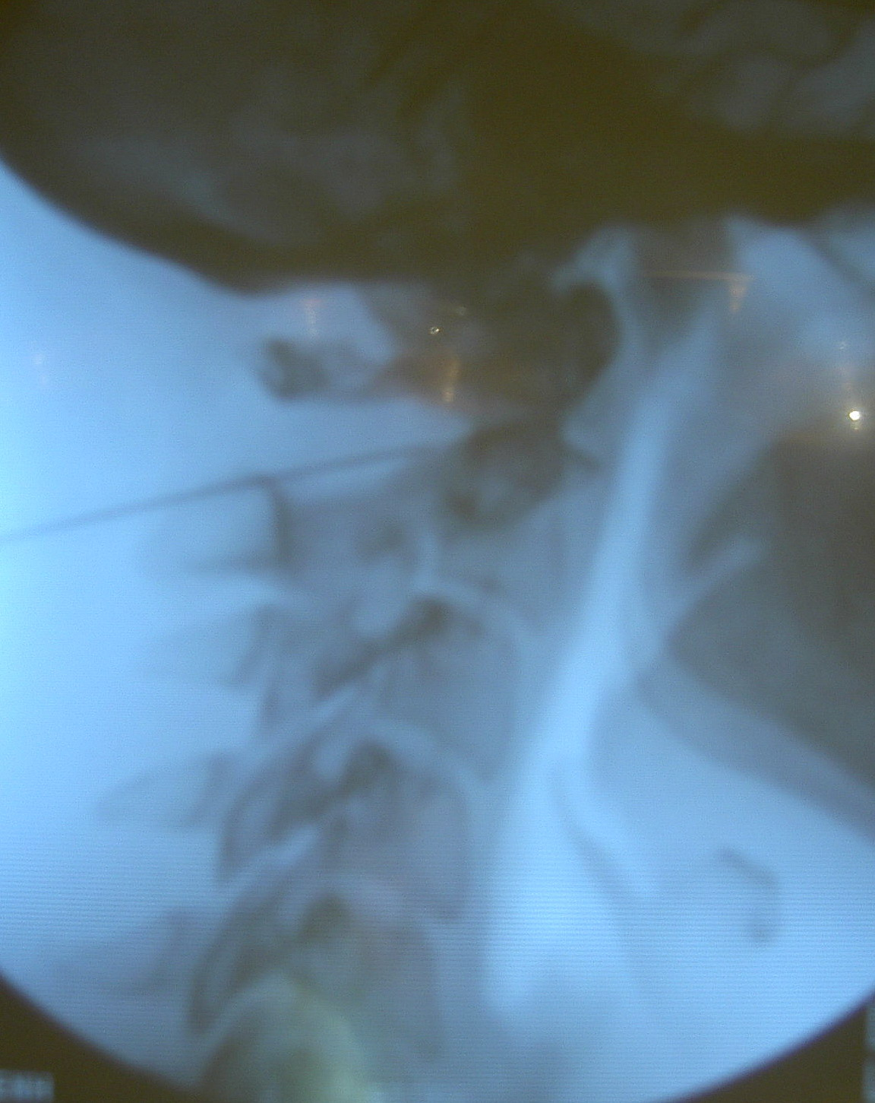
Infiltration Test of C0/C1/C2 under fluoroscopy ( C-arm )

Slide 33
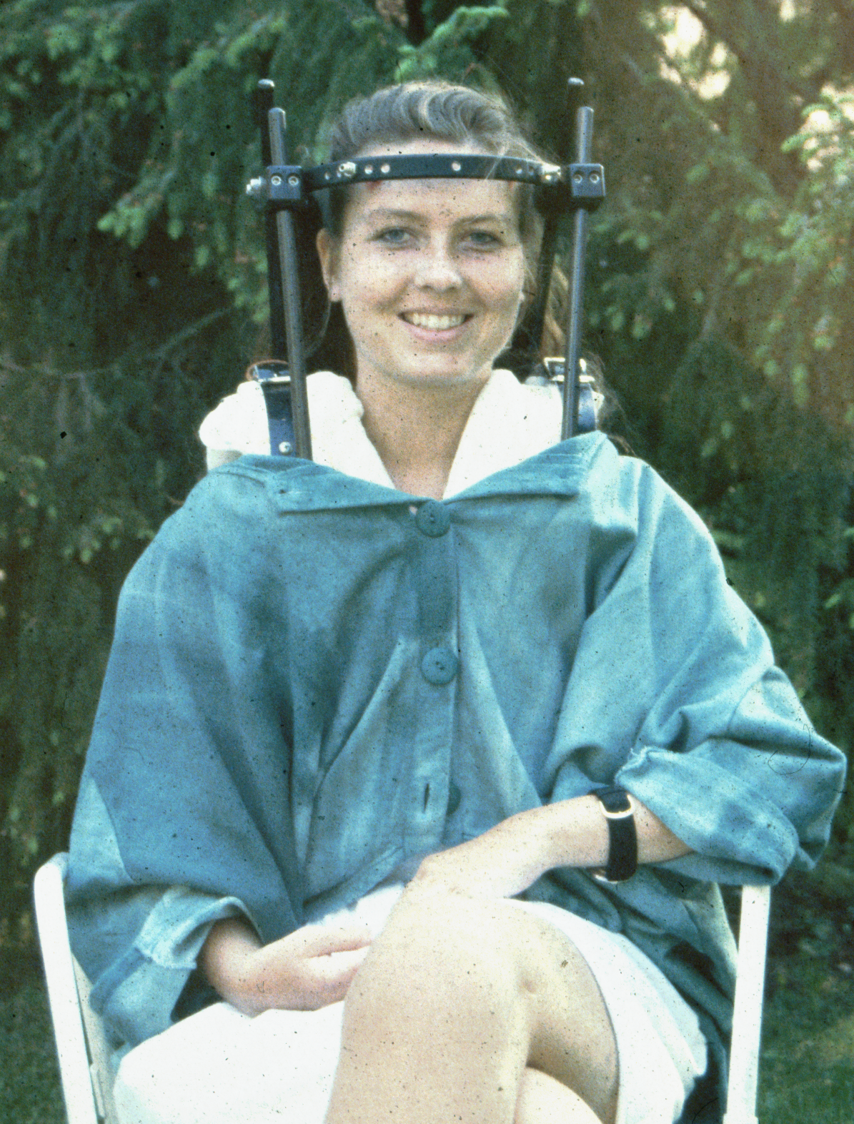
Optional Halo Fixation for One Week
External stabilization by using halo fixation
Checking the change of symptoms during one week

Slide 34
Treatment
Surgical
Stabilization operation of upper cervical joint
Non-Surgical
Physiotherapy??
Radiofrequency therapy
Magnet-wave therapy

Slide 35
Aim of The Operation
Stabilisation between C0/C1C/2
Stopping the sending of wrong impulses to brainstem

Slide 36
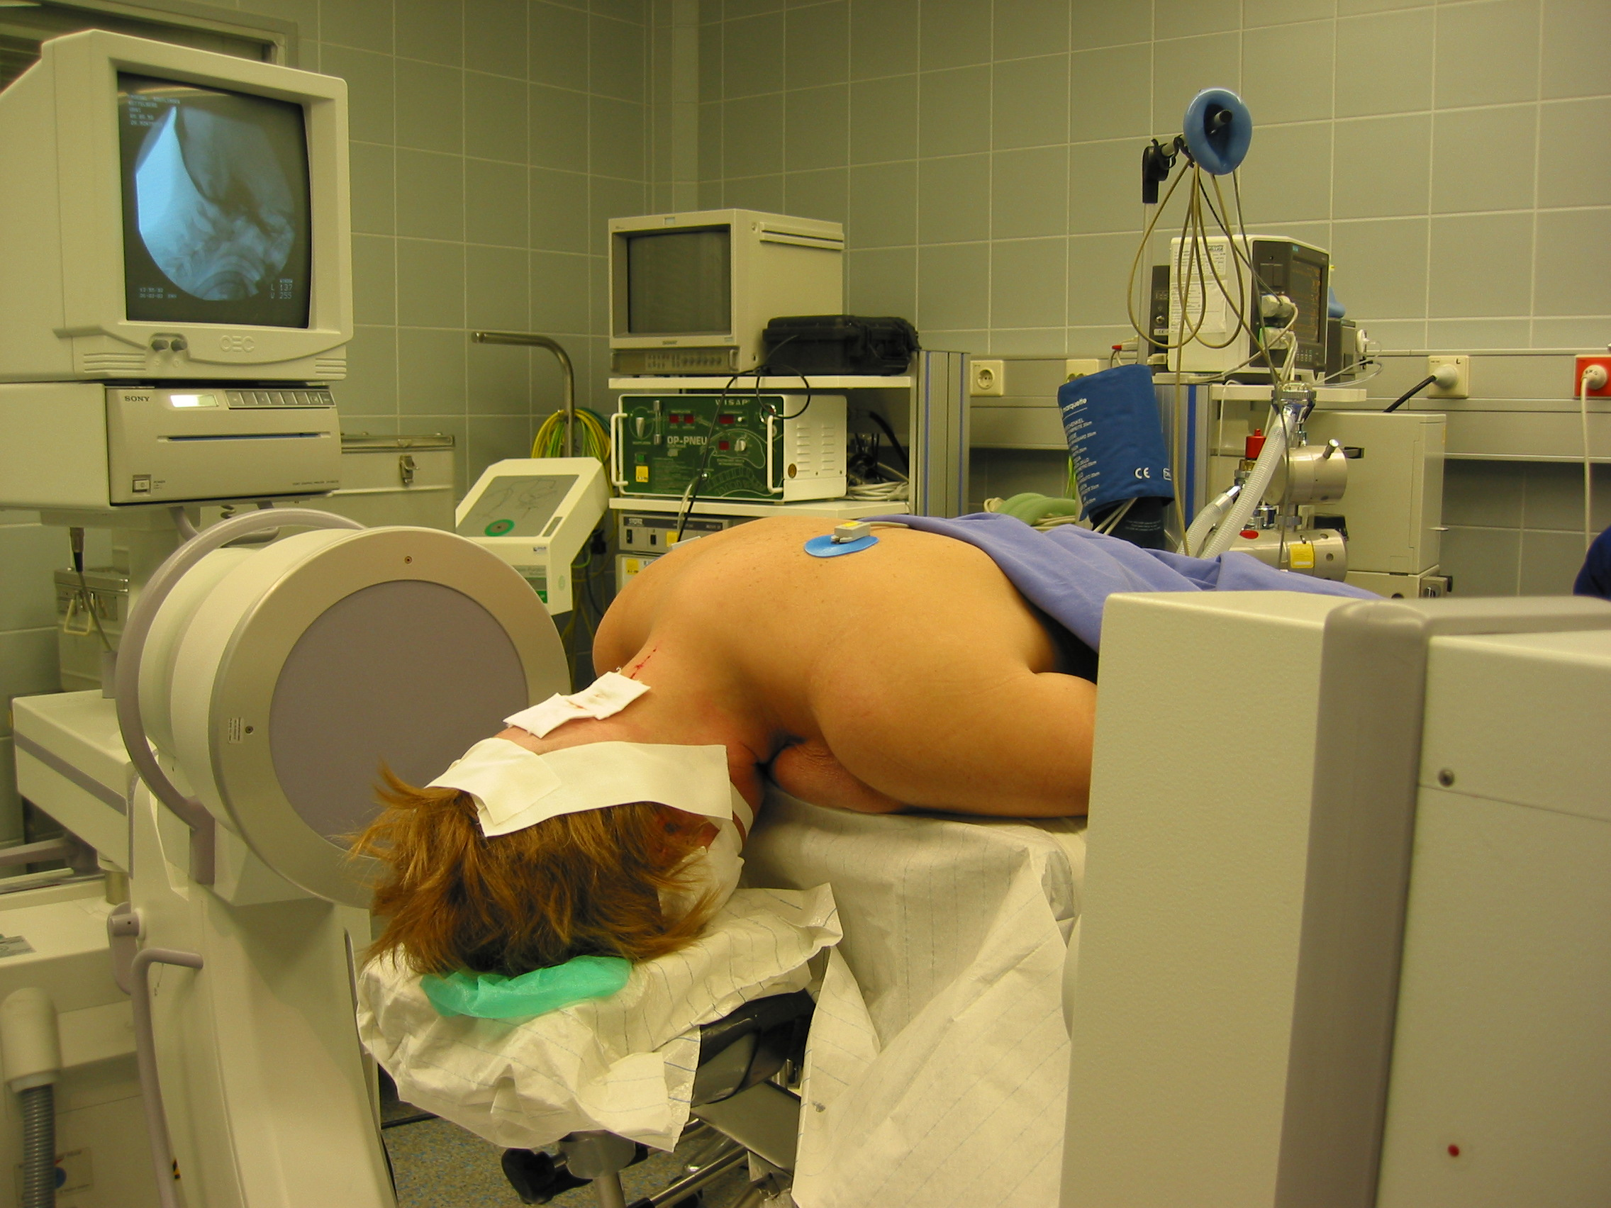
Technique of the operation
Positioning

Slide 37
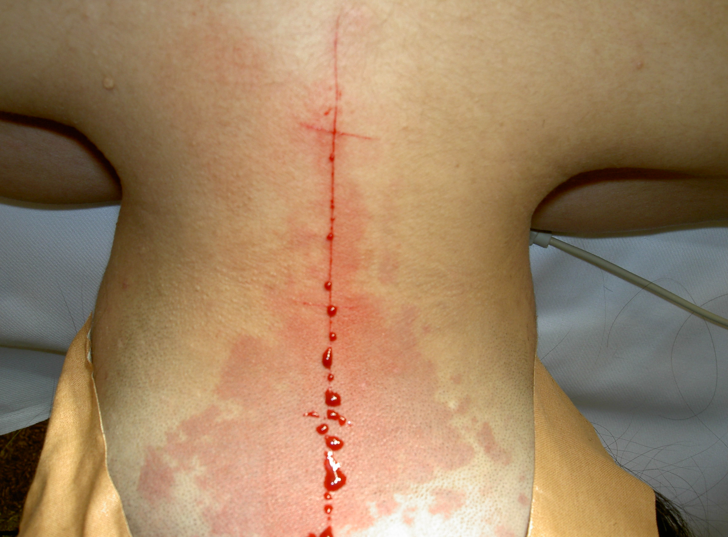
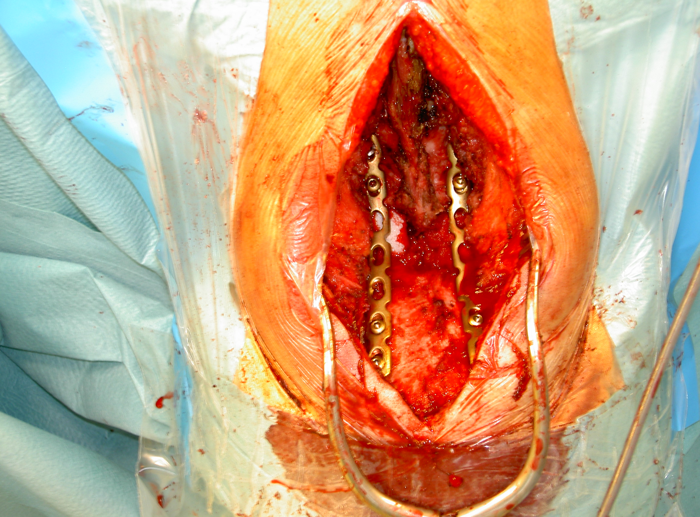
Operation
Incision line
Operation Approach

Slide 38
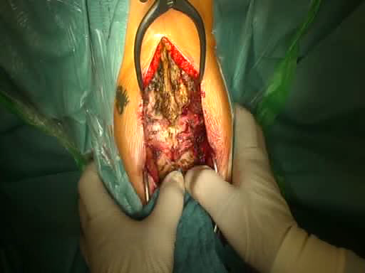
Pathological movement C0-C1-C2 A. Montazem

Slide 39
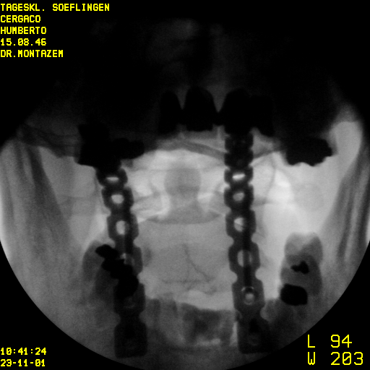
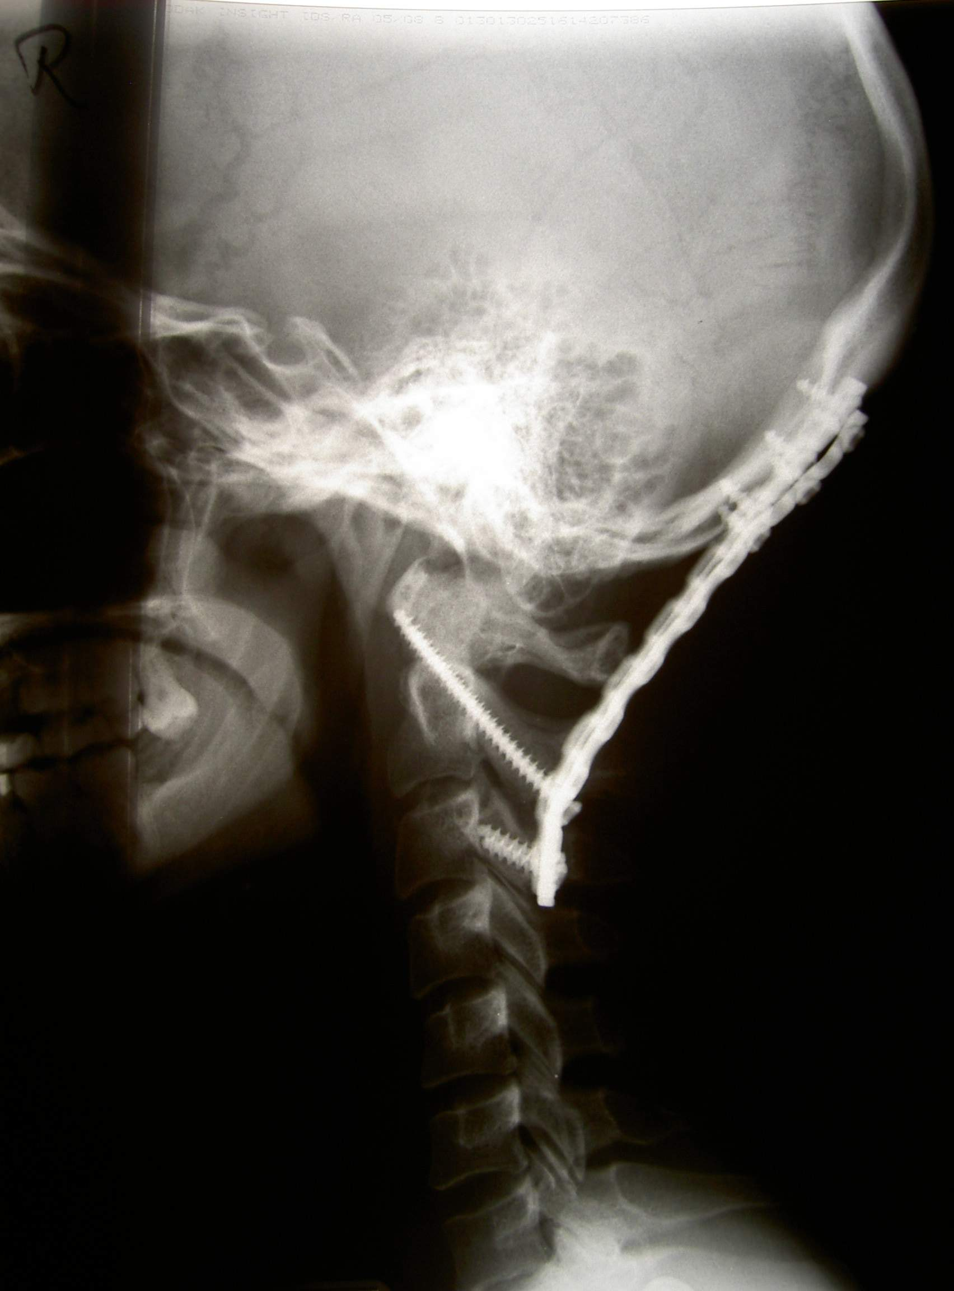
X-ray control after operation

Slide 40
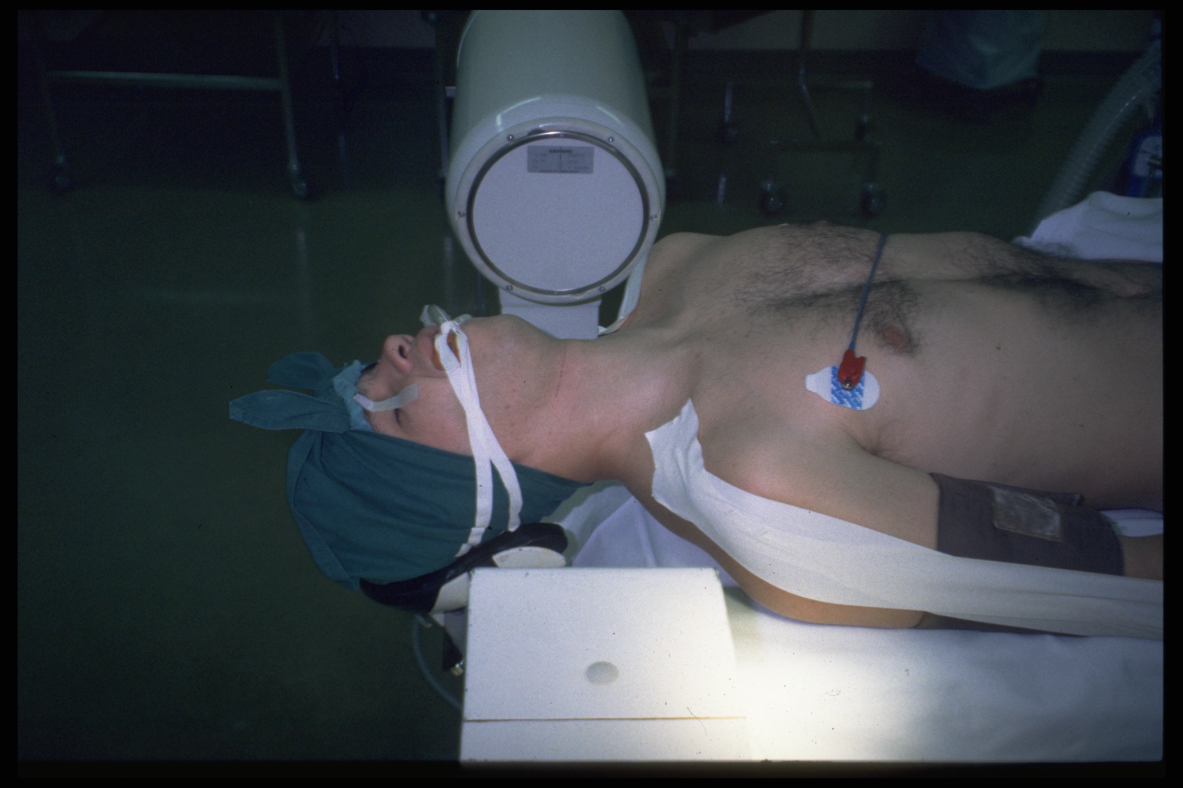
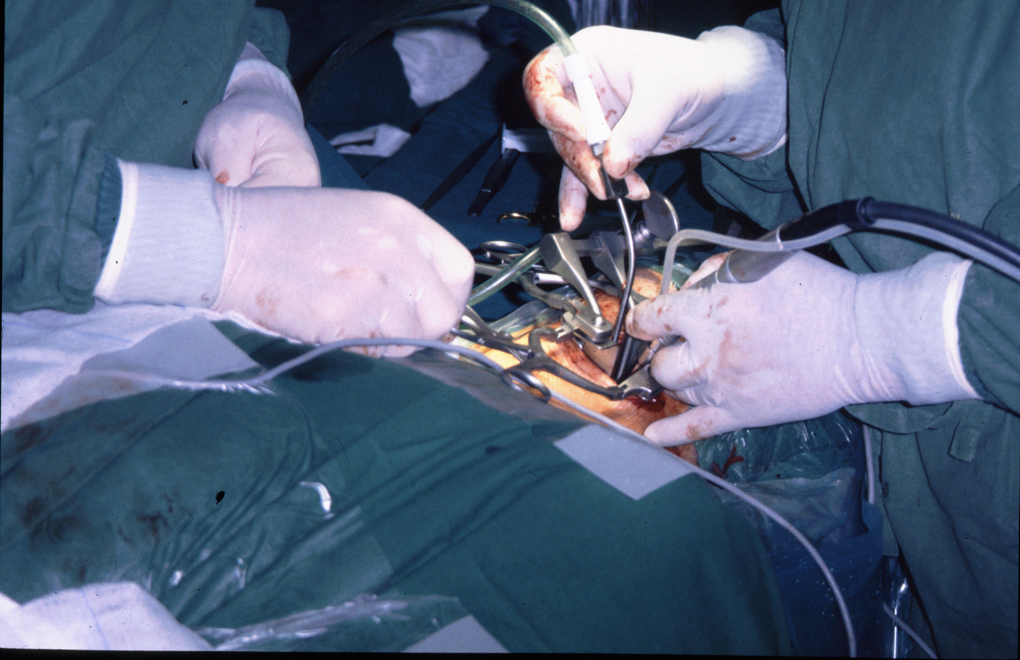
Op.Positioning for Ventral Approach on Middle Part of Cervical Spine

Slide 41
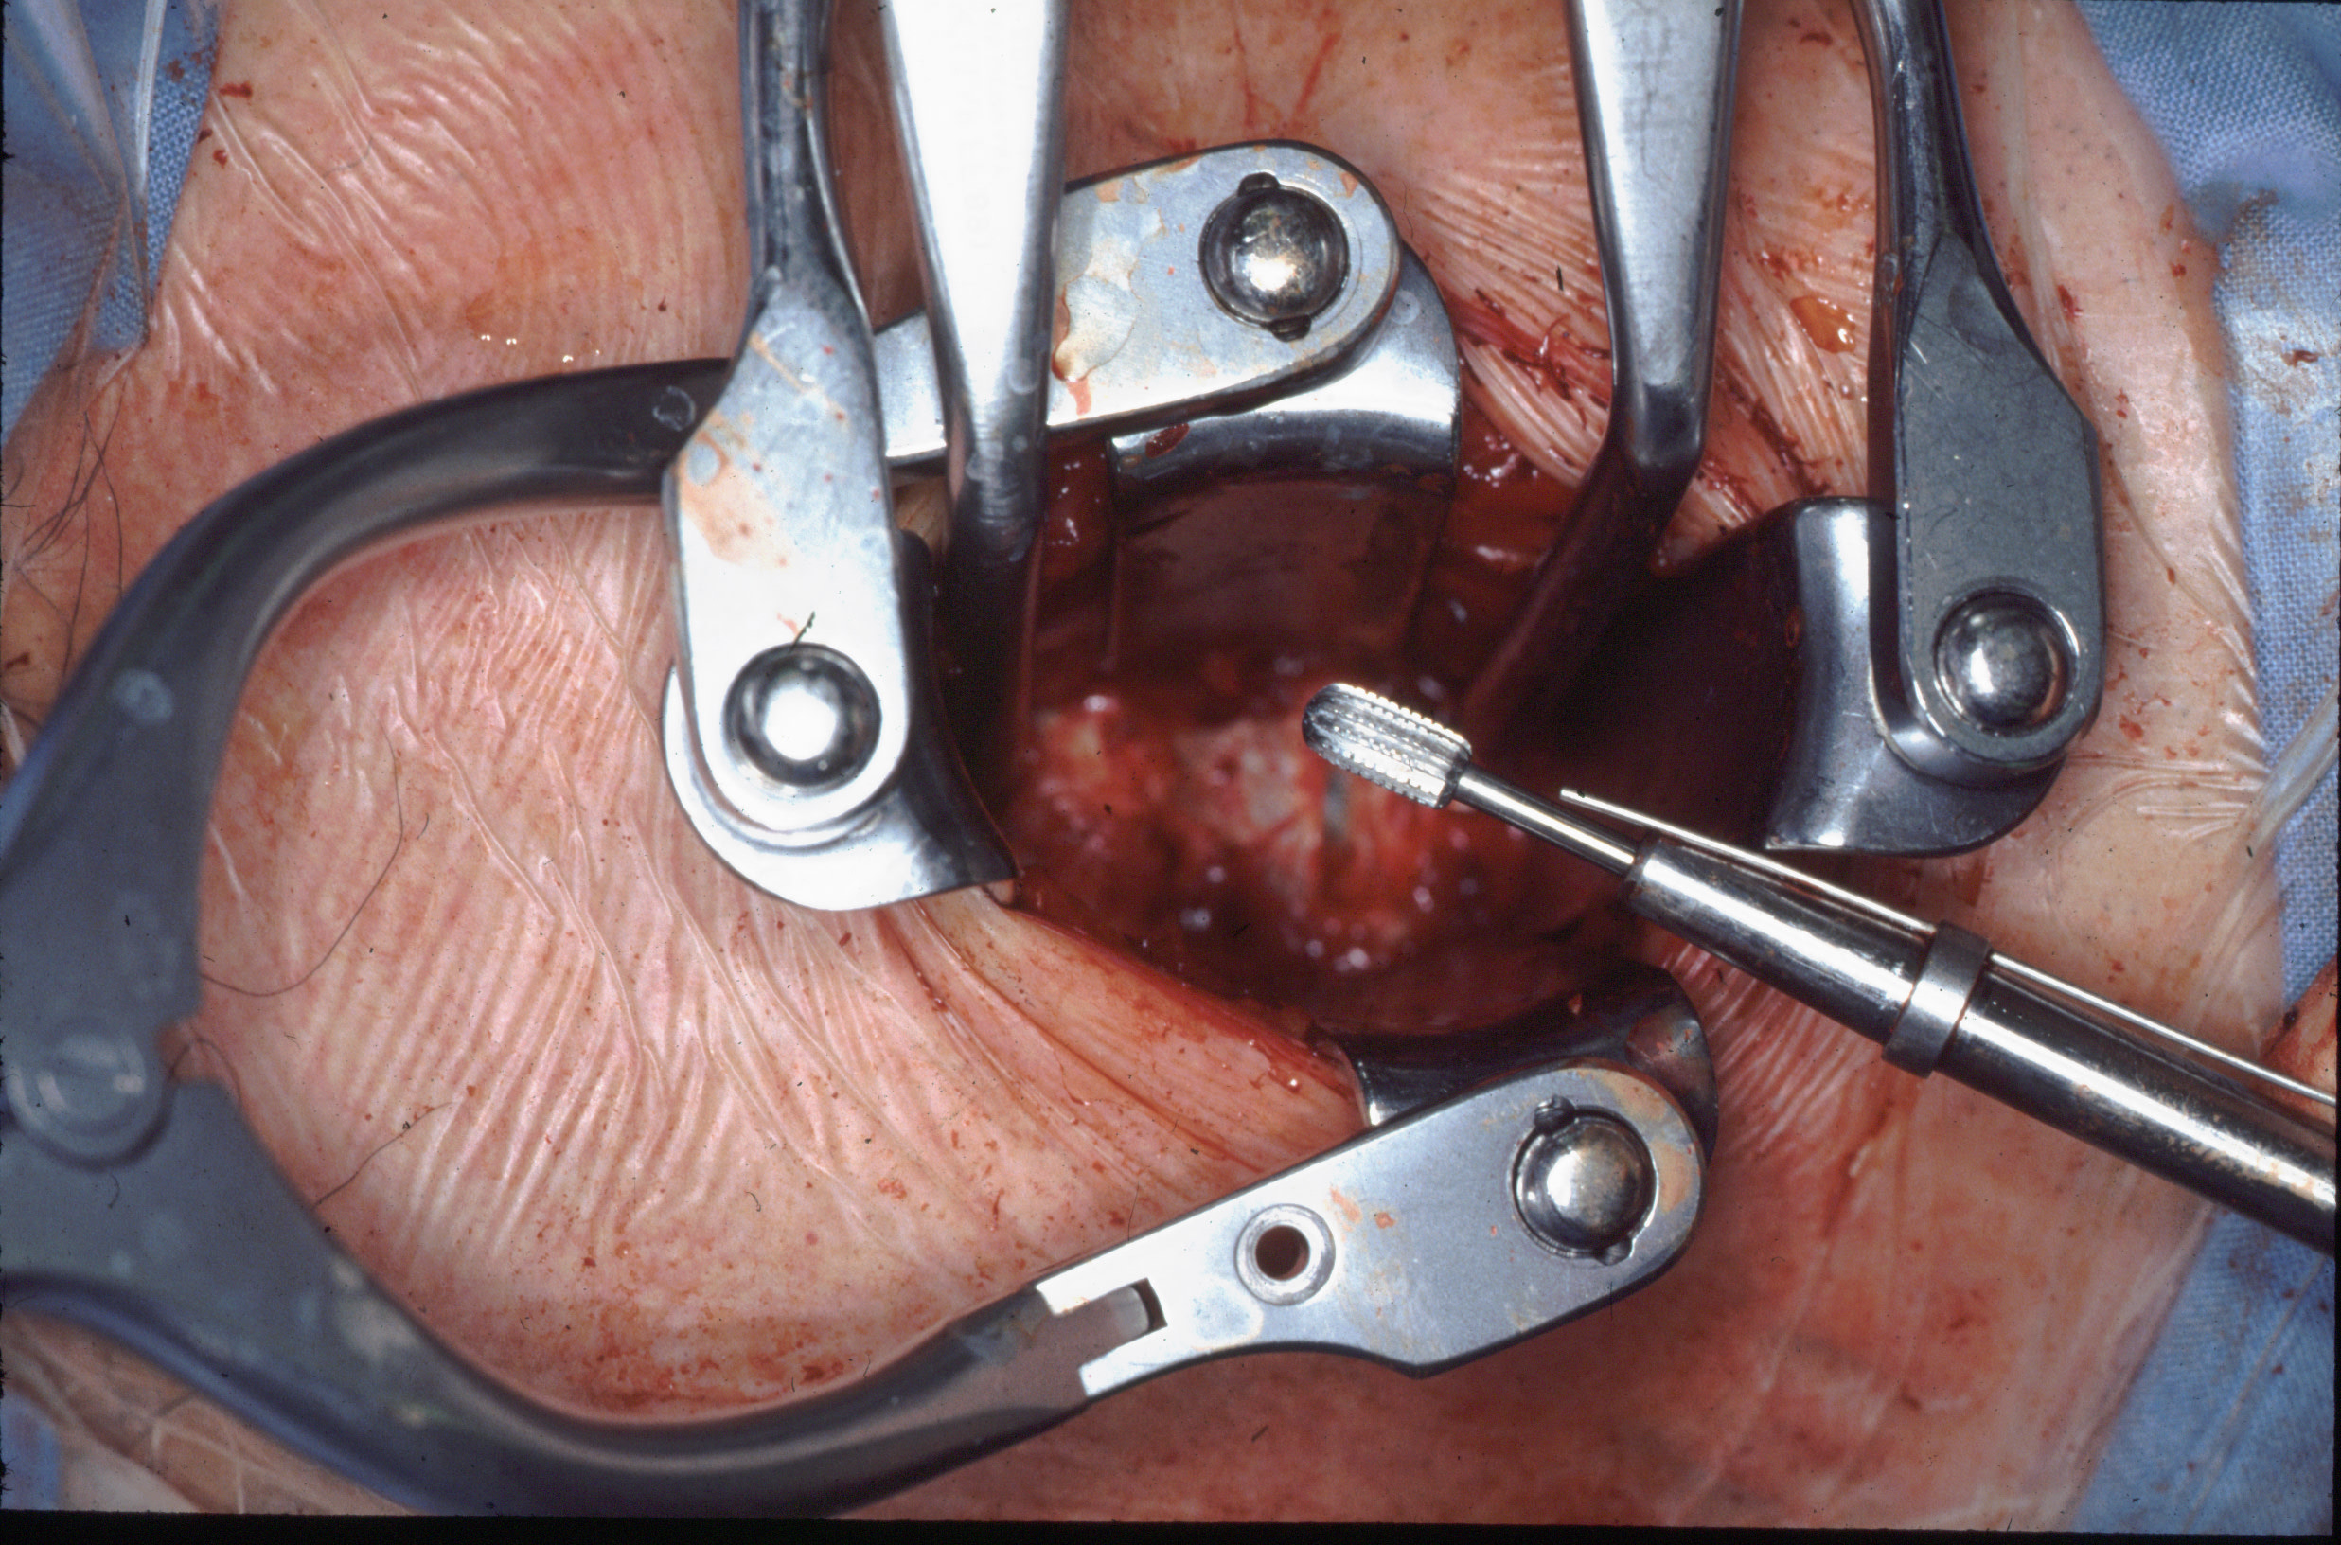
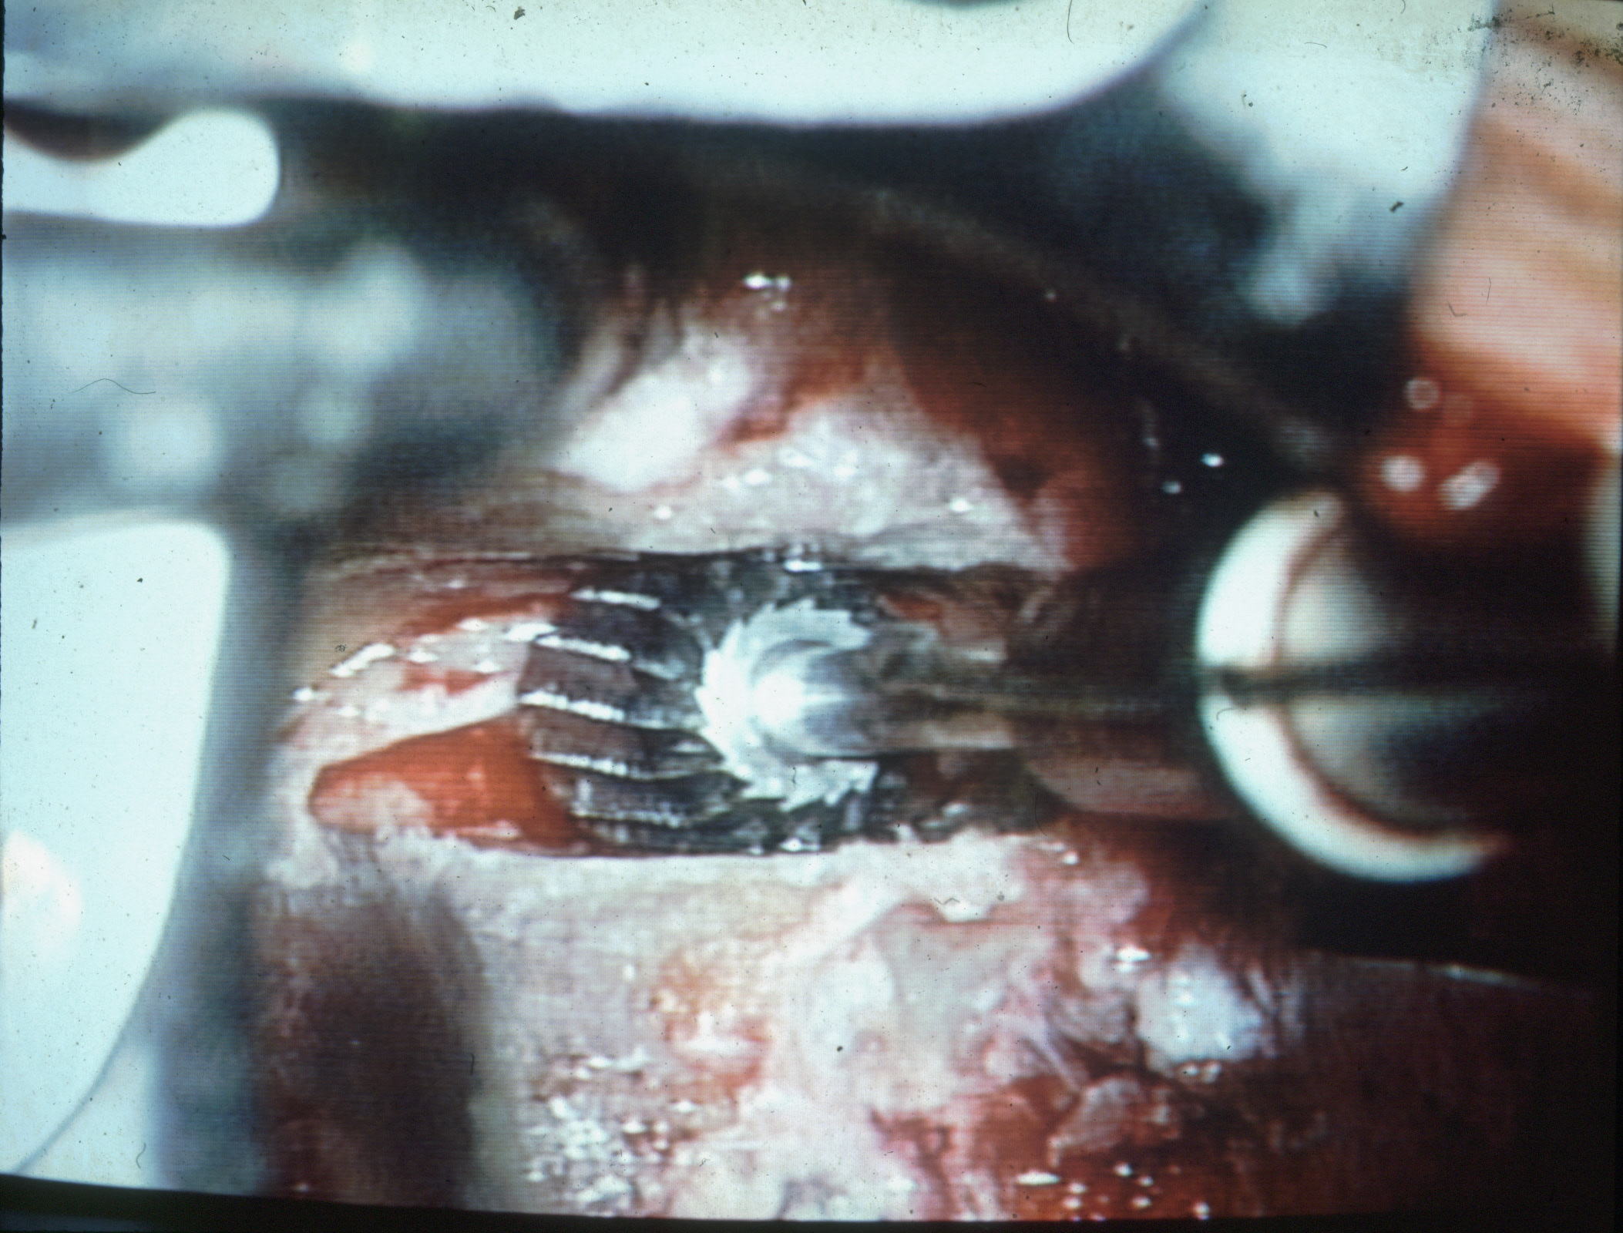
High Speed Drill

Slide 42
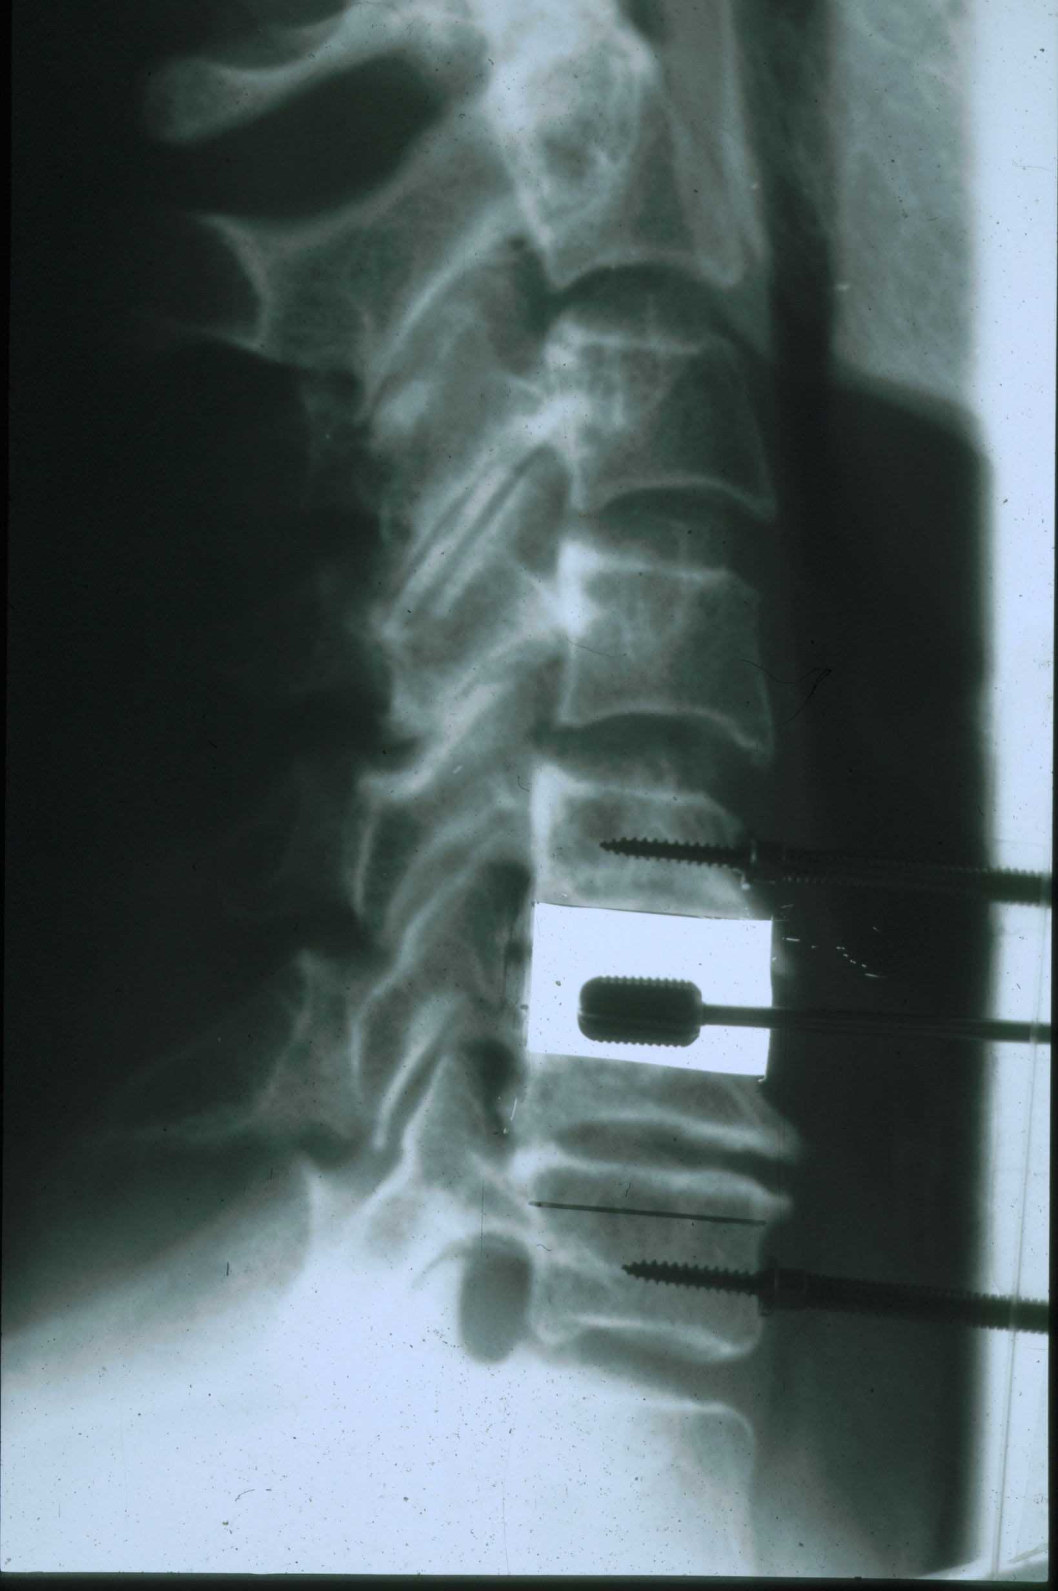
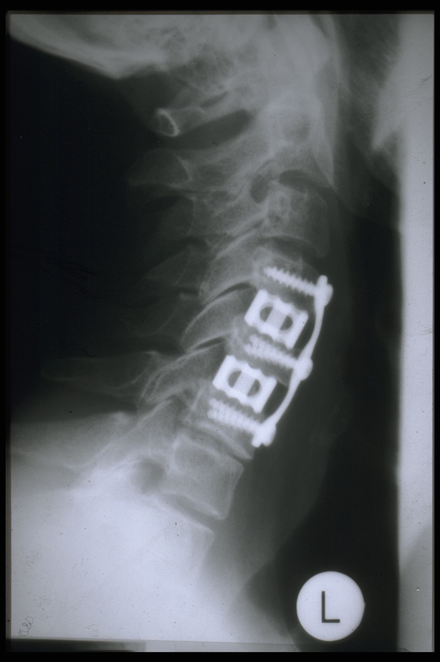
Using X- Ray During The Operation

Slide 43
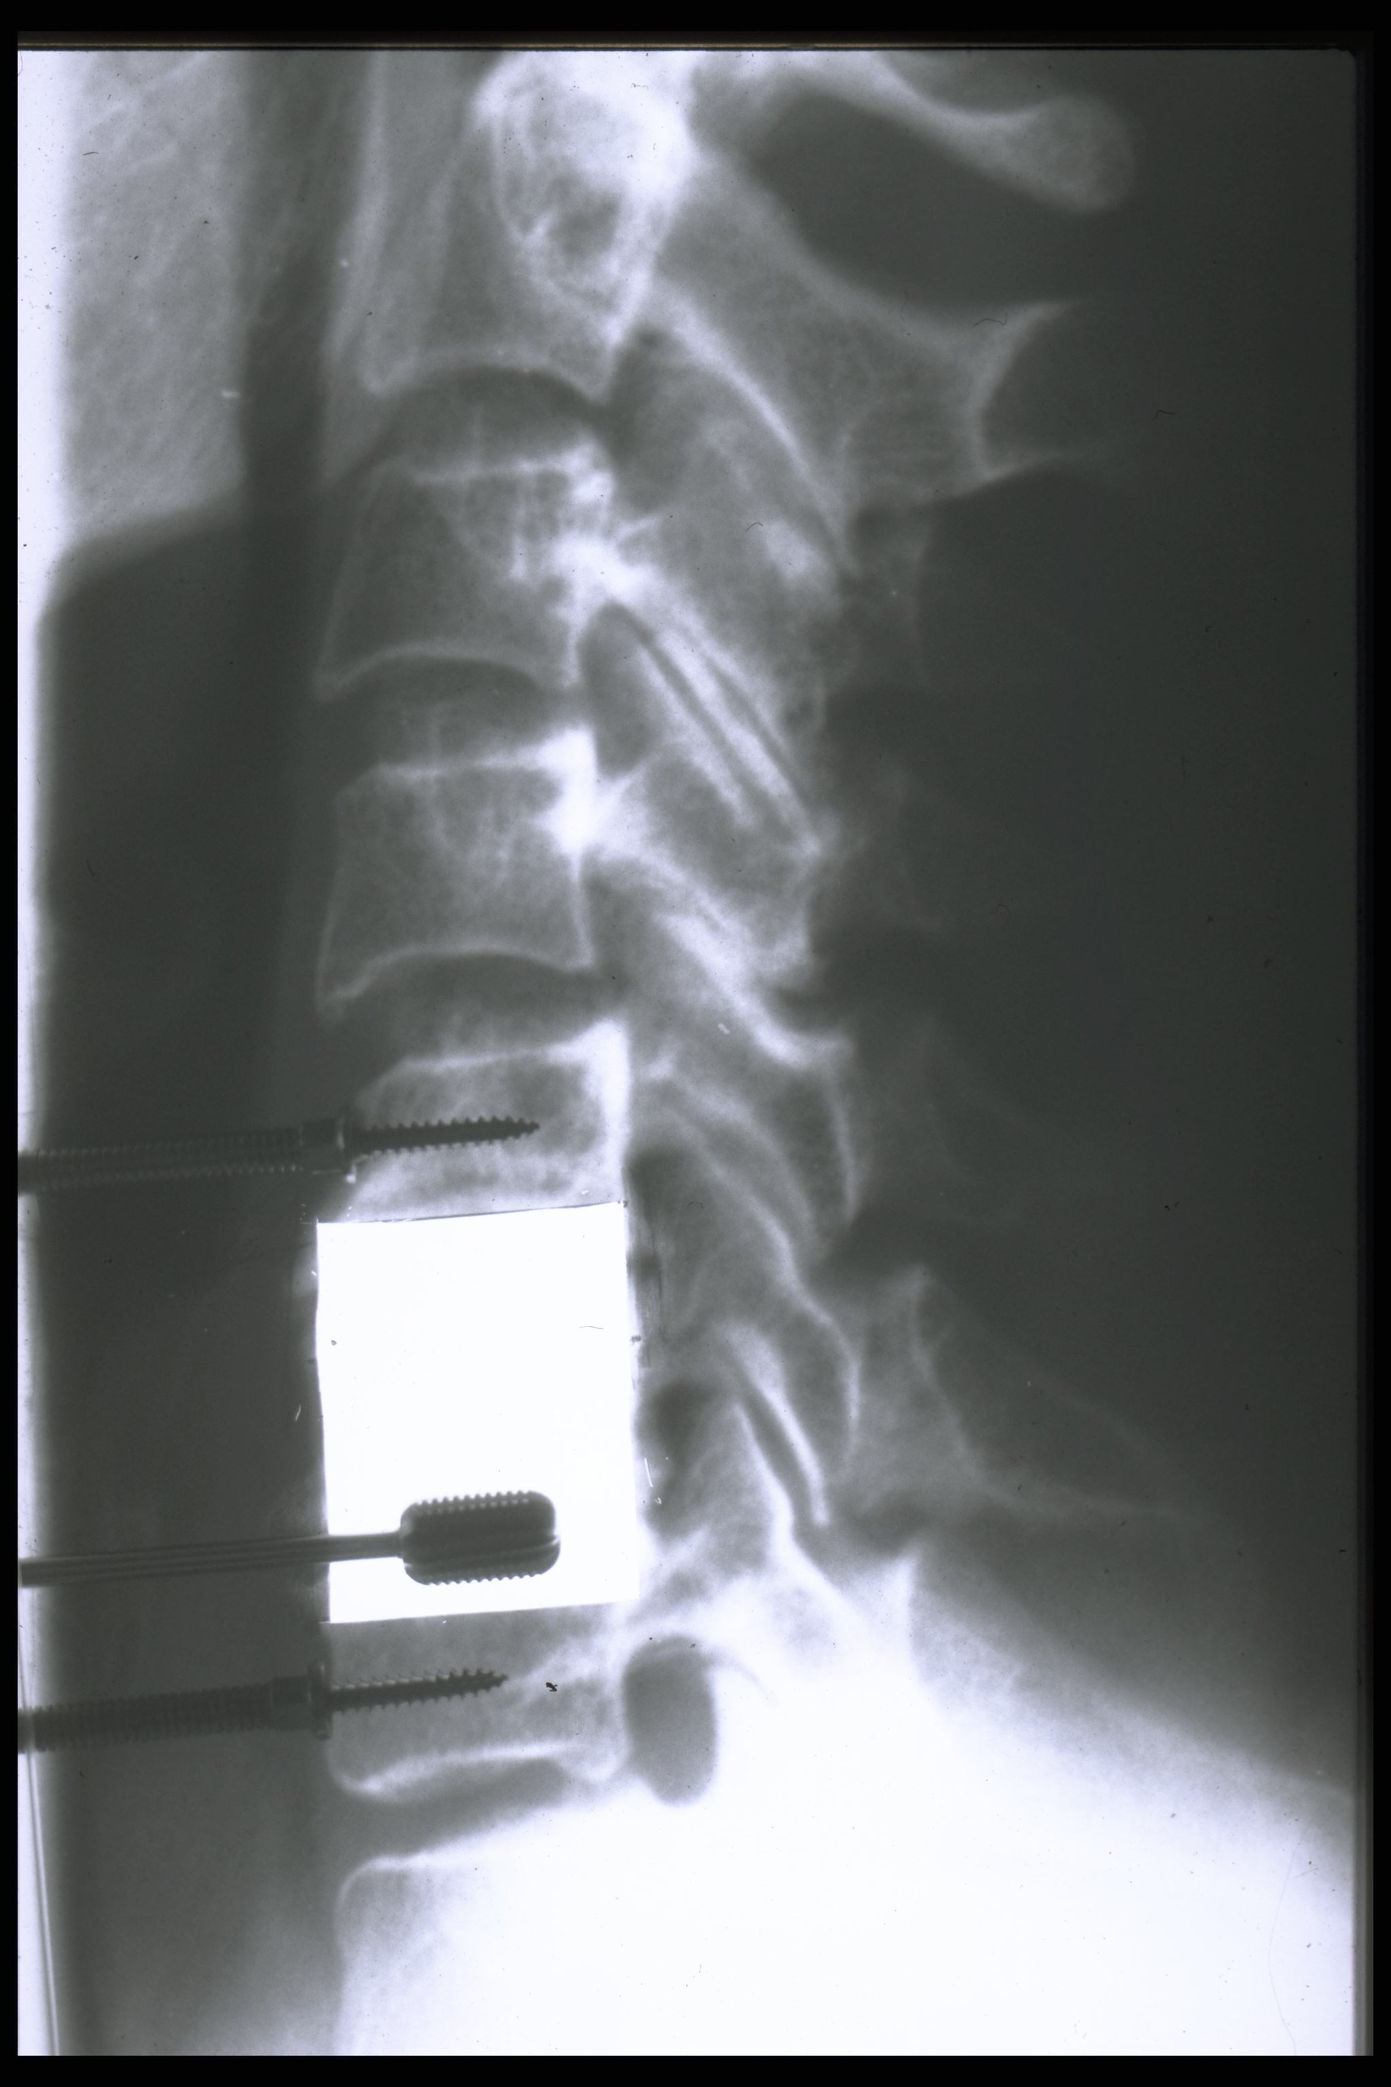
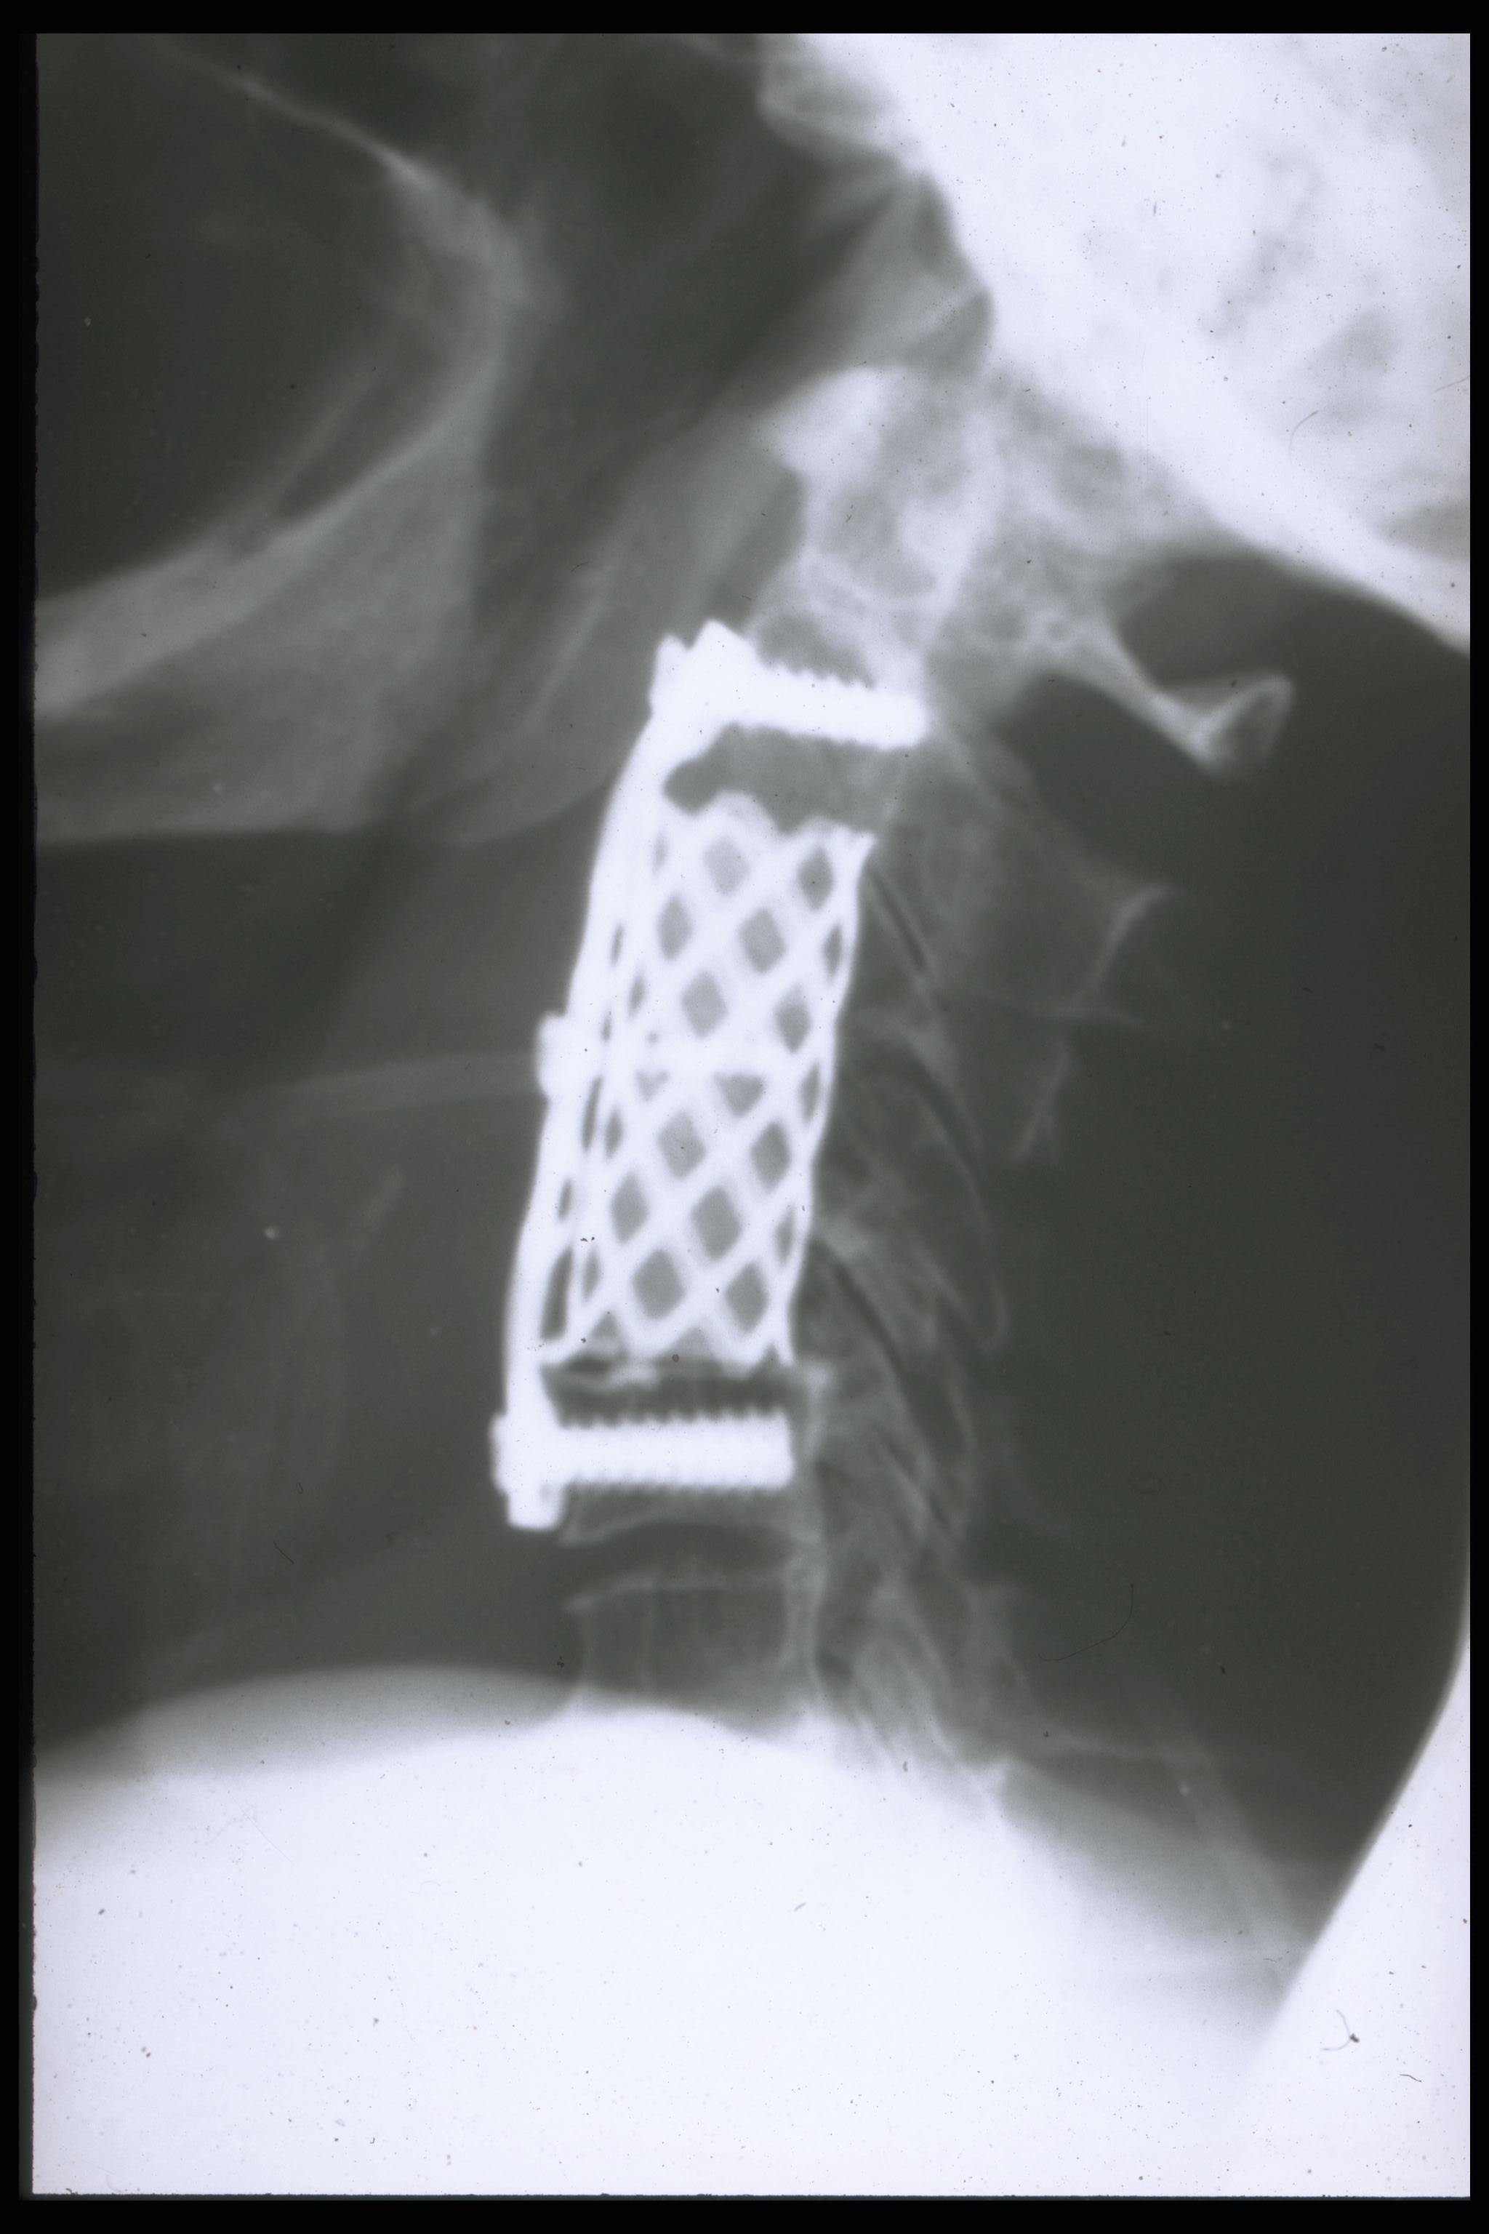
Removing of one or more Vertebra if necessary

Slide 44
Intervals of examination, care and support after the operation
One night intensive care unit.
The patients are mobilized on the first or second day after the operation.
Surgical adjustment of the geometry cause new tension of neck muscles.
Lymph drainages and the prescription of chewing gum are helpful.
Infiltration paravertebral with scandicain.

Slide 45
Clinical outcome and Result
Only Patients with Instability of Upper Cervical Joints

Slide 46
Operated patients with follow up
1999 to 2003 operated on 262 patients
114 of the patients were male, 148 female
The age range was from 17 to 68 years
44% car accident (half were not self fault)
27% sports accident
25% other accidents
4% had no remembrance of the trauma

Slide 47
Nationality

Slide 48
Different resultes from different Operation Methods
Aim is Stabilisation
Iliacrest bone graft wire fixation between Co/C1/C2 (65% of bone graft osteolysis)
Bone graft in combination with a thin titanium plate (16% morbidity after bone harvesting)
Stabilization from C0 to C3,transarticular C2/C1screwing and using thick plate

Slide 49
Best Result By Using Titanium 3mm Plates Between C0-C3 in Combination With Transarticular C1/C2 Screwing
Reversible operation
No bone graft (less problems after surgery)
No back out of screws or braking the thick plates

Slide 50
Best Outcome
Stabilisation with thick Titanium plates
Using 45 mm screws for transarticular fixation between C1/C2
Cranial fixation on occiput, distal on C3 facet Joint

Slide 51
Results
Because of vast diversity of symptoms it is not possible to come to a single analysis of surgical outcome

Slide 52
Results
Before Surgery
permanent headache78%
Permanent analgesics 100%
Inability to work 100%
After Surgery
Permanent headache22%
Permanent analgesics 26%
Inability to work 61%

Slide 53
Results
85% of patients stated that surgery hat significantly improved their quality of life
92% of the patients would agree again for the same operation
15 % of patients stated that surgery had not fulfilled their expectations

Slide 54
The period of time for the follow up after the operation
1. post op. exam. 7 days after op.
2. post op. exam. 6 weeks after op
3. post op. exam. One year after op

Slide 55
Complications
Loose screws at occiput 16%
Breaking of (thin) titanium plates 13%
One case of bending of C1/C2 screws due to physiotherapy
One case of subarachnoidal hemorrhage in the fossa posterior

Slide 56
Summary
The instability of upper cervical joint can often be detected by special processes of examining
If a conservative therapy fails, better results can very often be reached by an operative therapy.
A significant reduction of head mobility must be accepted.

Slide 57
We are at the start to begin to understand some consequences of whiplash related injuries. I see myself as a passionate ambassador to give patients with CCJ damage a better quality of life and a brighter future.

Slide 58
Montazem, Abbas MD. Consultant Neurosurgeon at Buehl Hospital Germany Home Page : www. montazem.de

Slide 59
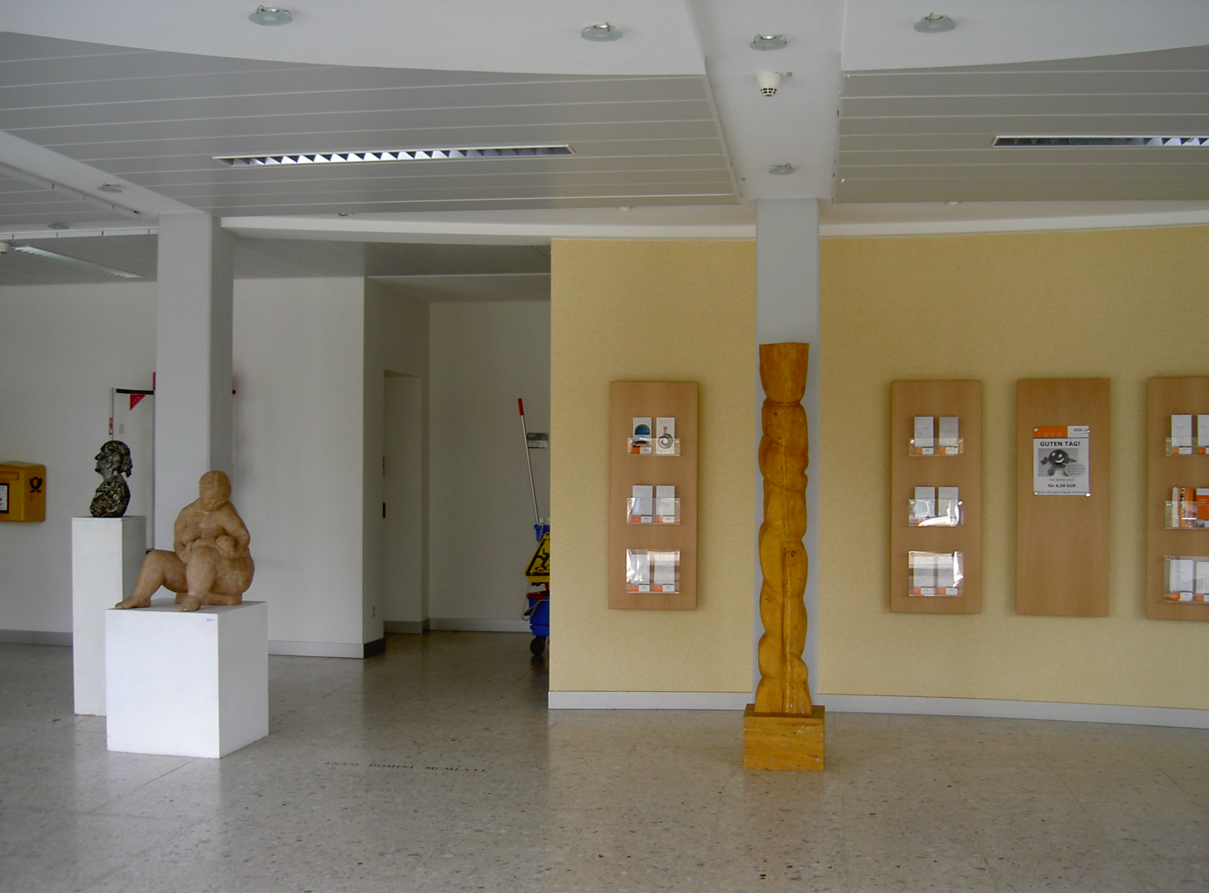
Entrance In Buehl Hospital

